Slide 1
NTA Spring Meeting 2018
Comments of Brian Galle
Georgetown Univ. Law Center
Brian.Galle@Georgetown.edu

Slide 2
What is the Incidence of SALT Caps?
Does deductibility impact state revenues?
  Yes: Metcalf (2011); cf. Galle & Klick (2010) (finding that deductibility affects state safety-net spending)
  No, but states reshuffle tax mix to maximize deduction: Chernick & Tenant (2010)
  Identification problems abound

Slide 3
What is the Incidence of SALT Caps?
Source: Galle (2014)
AJCA, enacted 10/2004 allows for
deductibility of state sales taxes,
effective 1/1/2004.

Slide 4
Effects on Local Governments
Combination of negative factors
  HMID and rising interest rates reduce individual property tax base
  SALT caps and loss of itemizers increase pressure on individual property tax rates
  Federal rate reductions reduce muni bond premium
Effects?
  Shift to commercial property tax
    SALT caps generally encourage business taxes
  More state-level spending?
  Borrowing: rational to shift payments to period when local revenues (hopefully!) have greater federal support

Slide 5
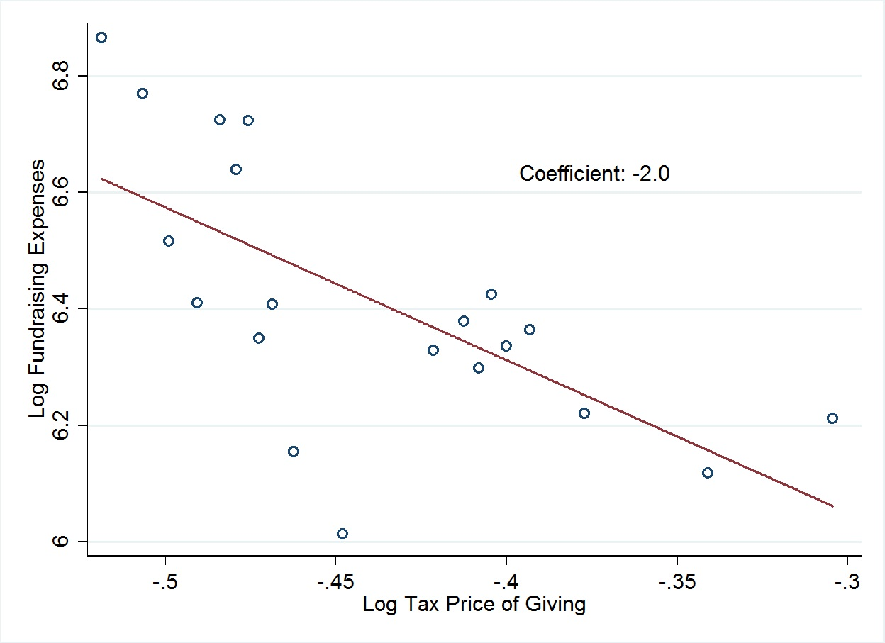
Do Tax Subsidies Increase Nonprofit Fundraising?
Log fundraising expenditures at
public charities in PC-SOI Sample,
1984 – 2007.
Tax price of giving is state
income-tax contribution to tax
price, calculated by Bakija &
Heim (2011)
Graph reflects firm- and state-
level controls, year effects,
and state by year trends.
Number of bins: 20
Source: Galle (2017) from PC-SOI and Bakija & Heim (2011)

Slide 6
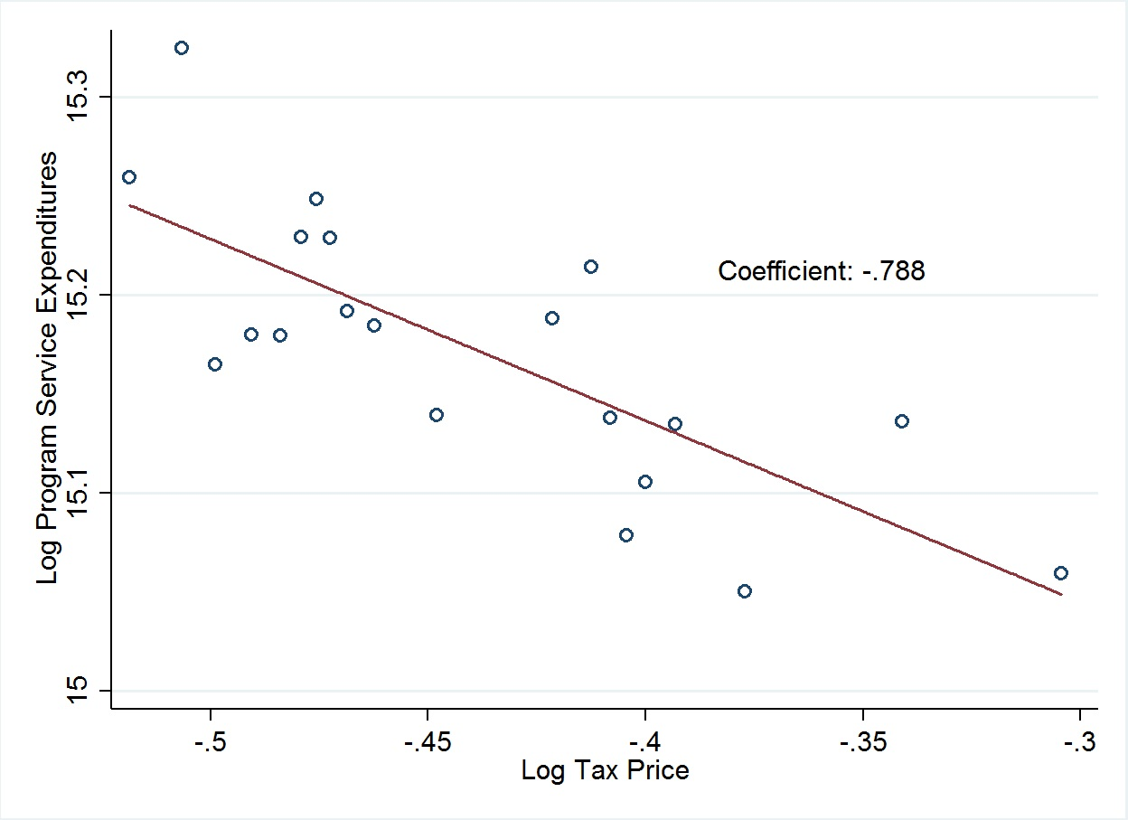
Net Effects of Tax Subsidies on Short-Run Charitable-Purpose Expenditures
Log expenditures at
public charities in PC-SOI Sample,
1984 – 2007.
Tax price of giving is state
income-tax contribution to tax
price, calculated by Bakija &
Heim (2011)
Graph reflects firm- and state-
level controls, year effects,
and state by year trends.
Number of bins: 20
Source: Galle (2017) from PC-SOI and Bakija & Heim (2011)

Slide 7
Other Good News for Charity?
SALT Limits Offset Federal Rate Cuts in Top Brackets
  SALT reduces value of state charitable contributions to (1- τ) * state rate
  New York $1m earner 2017: 39.6% + (1 - .396) * 6.85% = 43.73% net subsidy
  New York $1m earner 2018: 37 % + 6.85% = 43.85%
Pease Repeal
  Some givers had only ~ 8% marginal return on additional gifts
Bunching? Ackerman & Auten (2006)
Political Momentum for Credits?

