Slide 1
Tax Policy and Organizational Form: Assessing the Effects of the Tax Cuts and Jobs Act
Erin Henry*
University of Memphis
George A. Plesko*
Steven Utke
University of Connecticut
*Henry and Plesko hold positions as economists with the Statistics of Income Division of the Internal Revenue Service. The views expressed in this paper are solely those of the authors and do not represent those of the U.S. Department of Treasury or the Internal Revenue Service.

Slide 2
Research Agenda
Provide historical context to assess implications
Analyze organizational form choices after TRA86
Estimate magnitude of changing incentives of TCJA
Model effect of TCJA on organizational form choices
Evaluate anecdotal evidence
Summarize practitioner guidance and initial behavioral responses of firms

Slide 3
Historical Context: Tax Reform Act of 1986
Maximum corporate tax rate: 34% + earnings taxed at individual level when distributed
Maximum individual tax rate: 28%
Incentive to convert to pass-through form
Empirical evidence suggests business owners responded to the incentive.
Plesko (1994), Plesko (1995a,b), Ayers et al. (1996), Omer et al. (2000)
Notes:
In addition, preferential treatment for LTCG (reduced benefits of deferral), established AMT for corps

Slide 4
Historical Context: Tax Reform Act of 1986
How did business operations change in response to the change in organizational form?
Economic magnitude of business operations
Compensation mix
Payout policy
Related-party financing decisions
Notes:
We extend the literature by examining the response of business operations to the change in organizational form.

Slide 5
Historical Context: Tax Reform Act of 1986
Panel A: Number of Corporations by Entity Type Pre- and Post-TRA 86
Number of firms by Corporate Status Pre- and Post TRA86
Pre-TRA 86 | Post-TRA 86 | Weighted N
C Corporation | C Corporation | 400,045
C Corporation | S Corporation | 70,613
S Corporation | S Corporation | 129,945
S Corporation | C Corporation | 3,897
C to S Conversions by Year Post TRA86
 | Weighted N
1987 | 33,388
1988 | 21,865
1989 | 17,593
1990 | 6,080
Total | 78,926
70% of C to S Conversions

Slide 6
Historical Context: Tax Reform Act of 1986

Slide 7
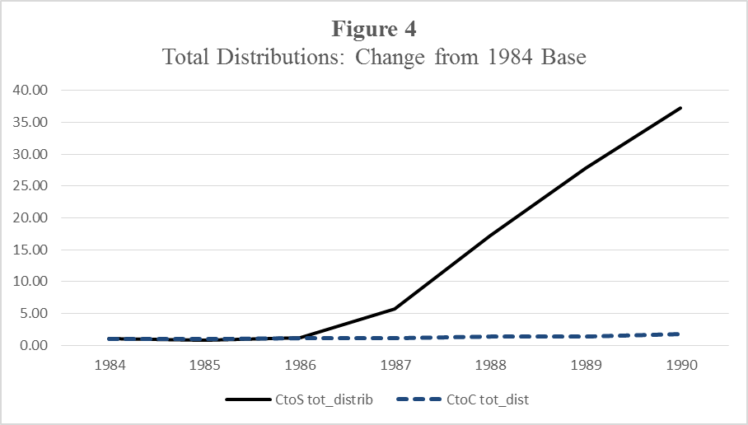
Historical Context: Tax Reform Act of 1986

Slide 8
Historical Context: Tax Reform Act of 1986

Slide 9
Modelling the Effect of TCJA on Organizational Form Choice
Simple model of organizational form choice:
(1-τ_{P}) > (1-τ_{C})(1-τ_{E})
After-tax return of passthrough entity
After-tax return of corporate entity
Post TRA 86 | 72% | 48%
Post TCJA | 63% | 63.2%
Notes:
Post TRA86: Even without distributions, the after tax rate of return of passthrough still exceeds after-tax rate of return for corporation of 66%
Post TCJA: After tax rate of return is higher for corporate form assuming no distributions - 79%
This assumes NO PASSTHROUGH DEDUCTION The passthrough deduction would make the after-tax return of a pass-through entity equal to 70.4%

Slide 10
Modelling the Effect of TCJA on Organizational Form Choice
Our model includes the effects of varying tax rates on methods of distributions to shareholder-employees:
Salary – self-employment tax rate
Dividends/Retained Earnings – preferential rates

Slide 11
Modelling the Effect of TCJA on Organizational Form Choice
We use our model to compare after-tax rates of return for:
C corporations, S corporations, Partnerships
Across low ($250,000) and high ($750,000) income scenarios
And various distribution scenarios
0%, 50%, and 100% distributions
Distributions comprised of 0%/100%, 50%/50%, and 100%/0% salary/dividend mix

Slide 12
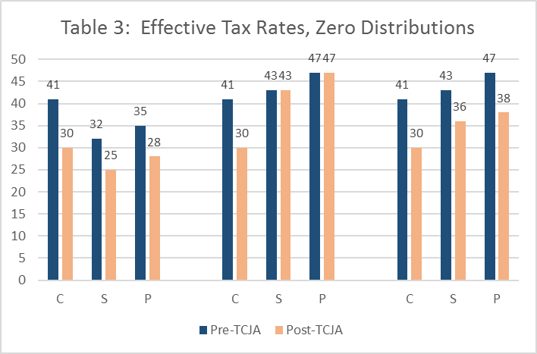
Modelling the Effect of TCJA on Organizational Form Choice
Low Income High Income – SERVICE High Income - MFG

Slide 13
Modelling the Effect of TCJA on Organizational Form Choice
Low Income High Income – SERVICE High Income - MFG

Slide 14
Modelling the Effect of TCJA on Organizational Form Choice
Low Income High Income – SERVICE High Income - MFG

Slide 15
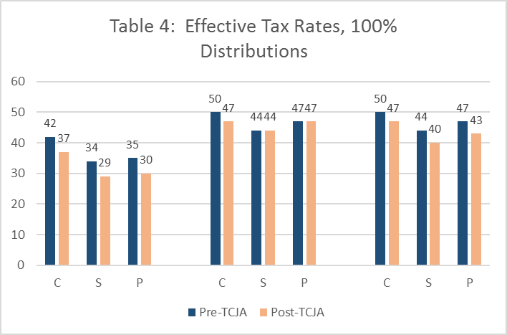
Modelling the Effect of TCJA on Organizational Form Choice
Low Income High Income – SERVICE High Income - MFG

Slide 16
Modelling the Effect of TCJA on Organizational Form Choice
Low Income High Income – SERVICE High Income - MFG

Slide 17
Modelling the Effect of TCJA on Organizational Form Choice
Low Income High Income – SERVICE High Income - MFG

Slide 18
Anecdotal Evidence
Be patient (in contrast to response to TRA86)
Uncertainty with respect to bill’s longevity and interpretation of its provisions
Many individual-specific circumstances are important in the decision (KPMG, BDO)
Non-tax costs may become important (in contrast to response to TRA86)
Ares Management LP and KKR & Co LP conversions

Slide 19
Summary and Conclusions
Response to TRA86 was swift in terms of organizational form and business decisions.
Response to TCJA will be slower and net effect will likely be smaller.
THANK YOU!

