Slide 1
TCJA and the State and Local Tax Deduction
National Tax Association 48th Annual Spring Symposium
May 2018
Frank J. Sammartino

Slide 2
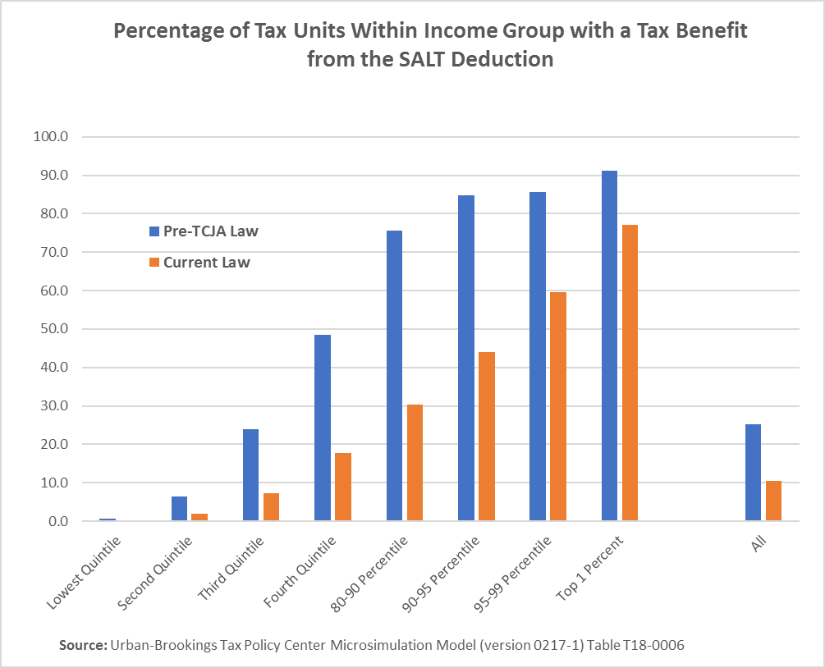
TCJA will reduce the number of taxpayers with a tax benefit from the SALT deduction by more than half.
About 60 percent of taxpayers in the 95-99 percentiles will continue to benefit from the deduction as will more than three-quarters of taxpayers in the top 1 percent.

Slide 3
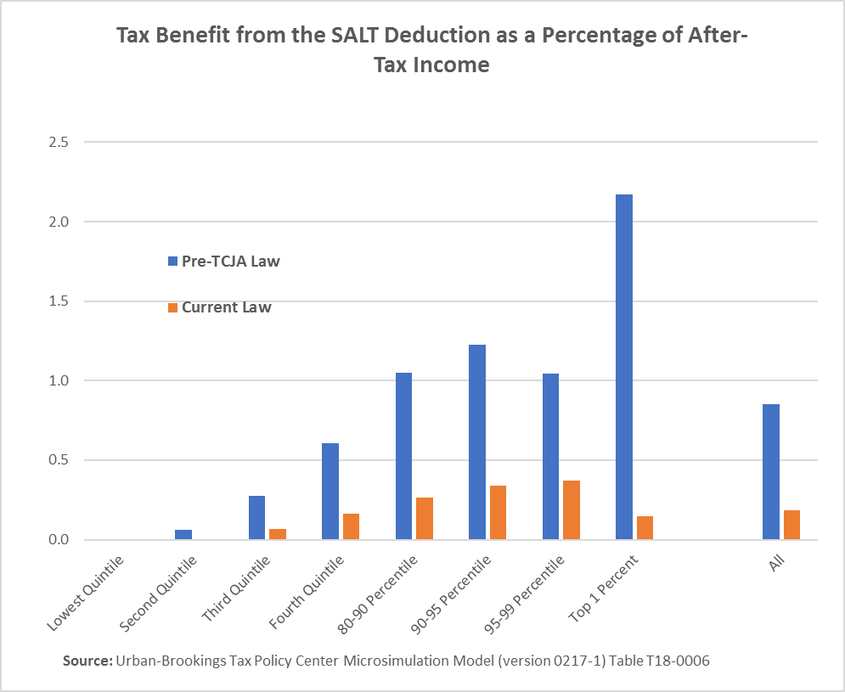
The tax benefit from the SALT deduction will fall by over 70 percent for most income groups. It will fall by more than 90 percent for taxpayers in the top 1 percent and by about 65 percent for taxpayers in the 95-99 percentiles.

Slide 4
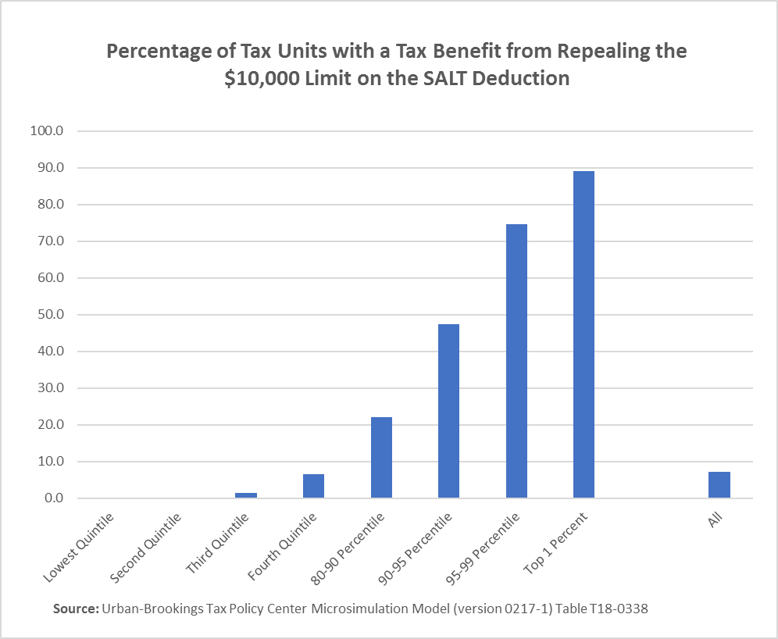
The limit on the SALT deduction increases taxes for 7 percent of taxpayers. But it increases taxes for three-quarters of taxpayers in the 95-99 percentiles, and almost 90 percent of taxpayers in the top 1 percent.

Slide 5
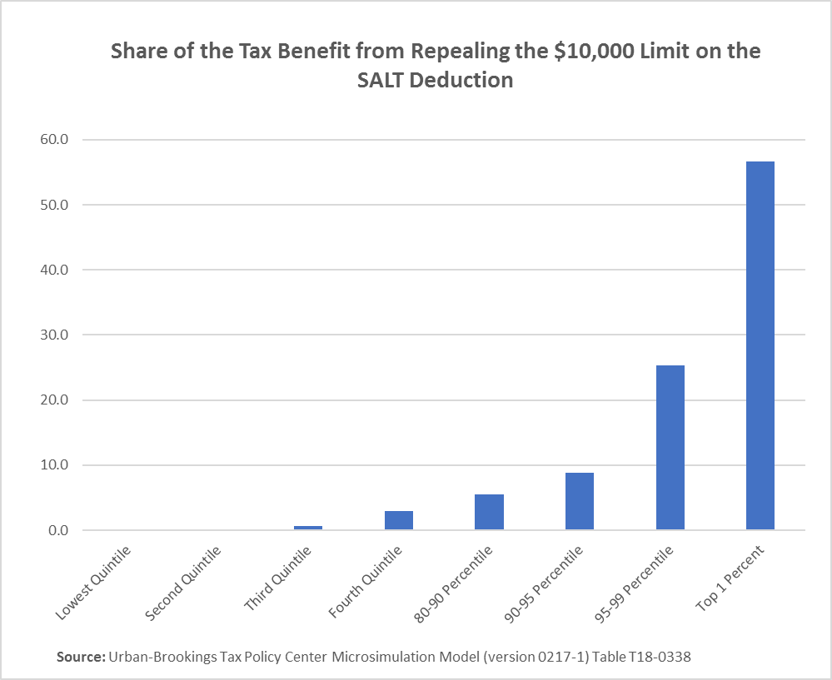
The top 10 percent of taxpayers pay over 90 percent of the additional tax from the limit on the SALT deduction. The top 1 percent alone pays about 57 percent of the additional tax.

Slide 6
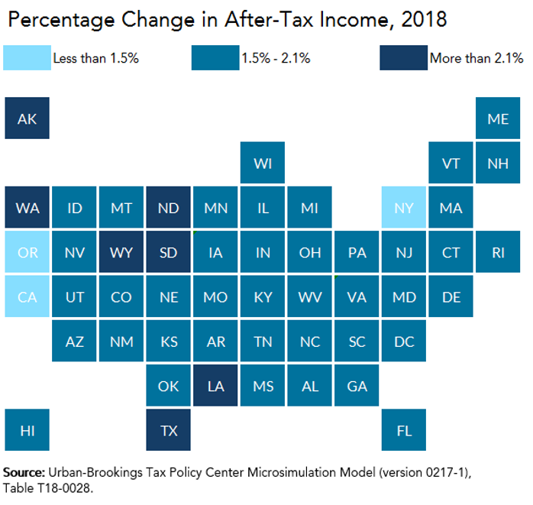
The average net tax cut differs by state.
It is highest in AK, LA, ND, SD, TX, WA, and WY, and lowest in CA, NY, and OR.

Slide 7
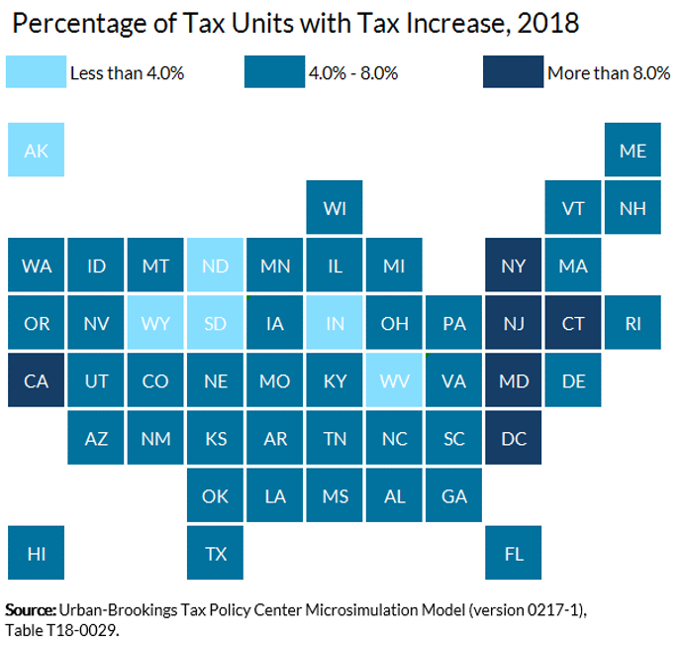
The percentage of taxpayers with a tax increase is highest in CA, CT, DC, MD, NJ, and NY.

Slide 8
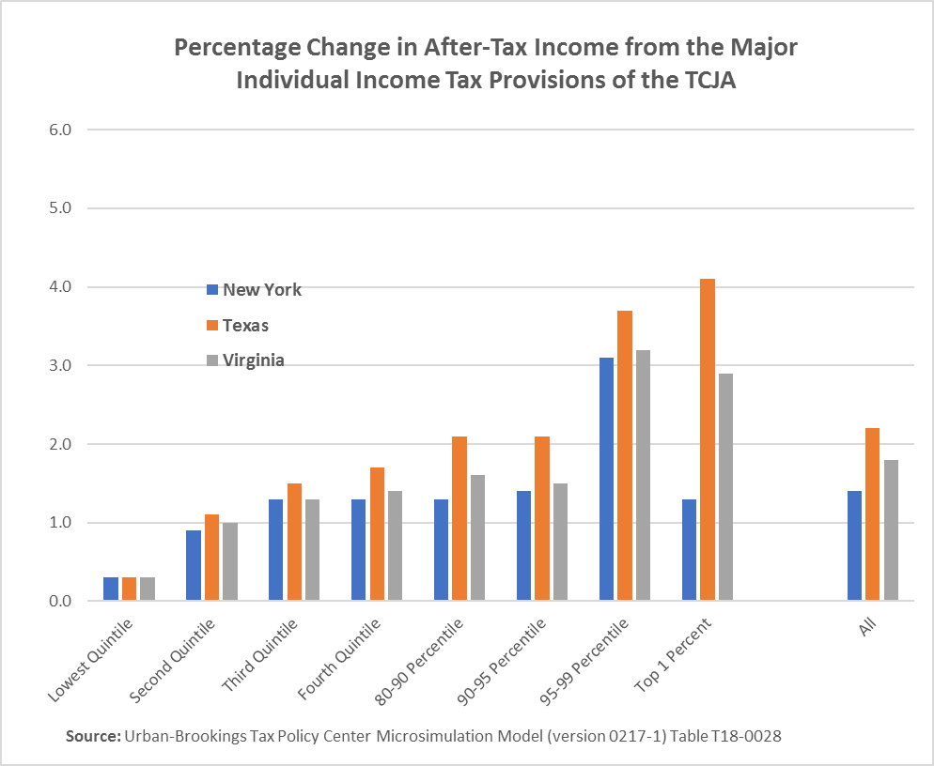
The average net tax cut is similar across NY, TX, and VA for taxpayers in the three lowest income quintiles, but there are notable differences among higher-income groups.

Slide 9
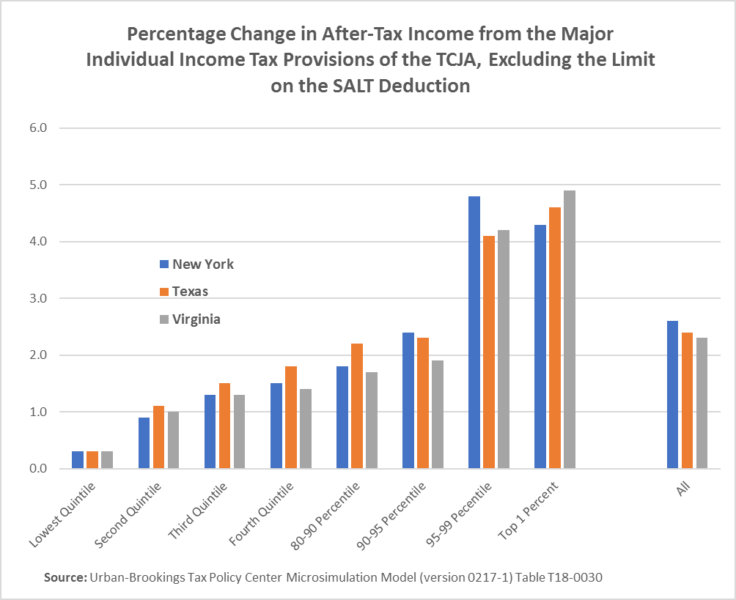
Eliminating the limit on the SALT deduction removes much of the cross state differences.

Slide 10
