Slide 1
Tax Increment Financing in Indiana
Anita Yadavalli, Ph.D.
Senior Fiscal Analyst
Indiana Legislative Services Agency

Slide 2
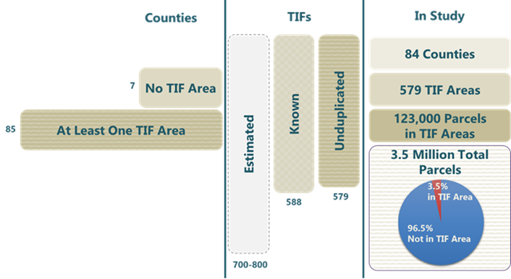
Background of TIF in Indiana
A TIF area may be established within a blighted area to promote redevelopment (22% of TIF areas) or spur new economic development (78%)

Slide 3
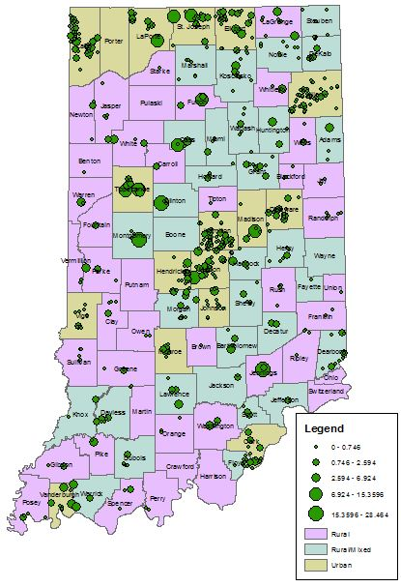
TIF Area Characteristics
Large concentration of TIF areas in “donut” counties around Indianapolis
Urban counties tend to designate more TIF areas

Slide 4
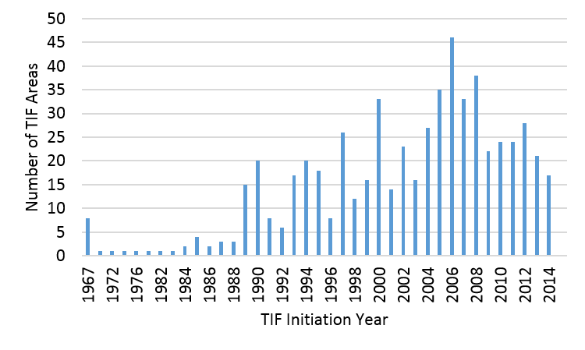
Initiation of TIF Areas
Initiation may have some correlation with U.S. recessions, particularly those of the mid-1990s, early 2000s and late 2007
Flourished immediately before and waned during the onset of those recessions

Slide 5
Econometric Results
AV
Average TIF property displays higher AV than average non-TIF property
AV Growth
Average TIF property may grow by slightly more than its non-TIF counterpart
Employment
No impact
Employment Growth
No impact

Slide 6
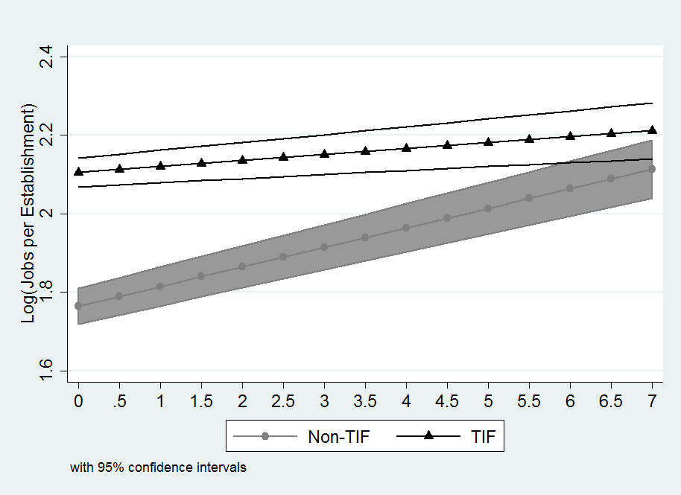
Interaction Effects
TIF establishments tend to create more jobs than their counterparts at low and high effective tax rates alike
City planning and population demands
Effect of Effective Tax Rate on Job Creation

Slide 7
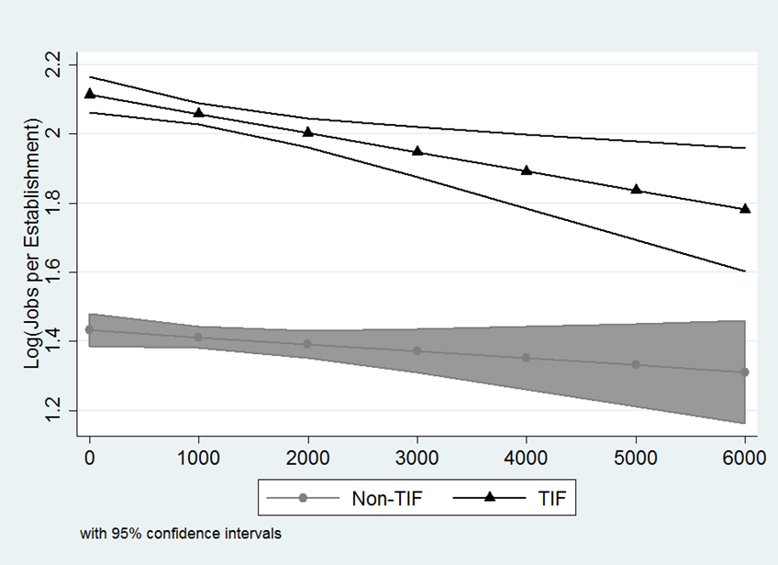
Interaction Effects cont.
TIF establishments tend to create fewer jobs at high levels of population density than at low levels, albeit still more than non-TIF establishments
Effect of Population Density on Job Creation

Slide 8
Thank you Anita Yadavalli anita.Yadavalli@iga.in.gov

