Slide 1
Infrastructure Spending:
After the Great Recession and Historically
Ronald Fisher
Michigan State University
National Tax Association, November 2016
(Work in progress)

Slide 2
State-Local Capital Spending
Substantial in FY 2013
  $323 billion
  1.9% of GDP
  $1,000 per person
  10% of state-local expenditure
Infrastructure Depreciation
Effects on Economic Growth
Recessions
  2001, 2007-09

Slide 3
Great Recession
Begins December 2007 = Middle of FY 2008 for most state governments (July 2007-June 2008)
Ends June 2009 = End of FY 2009 in most cases (July 2008-June 2009)
FY 2007 clearly before the Recession
FY 2010 after the Recession, but budget planning during the Recession
FY 2011 first real post-Recession year
ARRA, February 2009 (FY 2009)

Slide 4
What is State-local Capital Expenditure?
Census Bureau data; definitions
Construction of buildings, roads, and other improvements
Purchases of equipment, land, and existing structures
Payments on capital leases
Distinguish between “construction” and “other”
  Not maintenance as opposed to new

Slide 5
Capital Outlay Since the Great Recession
Since FY 2009
  Real per capita spending decreased
  Spending as a fraction of GDP and personal income decreased
  Capital outlay as a fraction of total state-local spending decreased
Spending increased during the recessions and fell after

Slide 6
Capital Outlay Since the Great Recession
Substantial changes since FY 2009
  20 percent decrease in real per capita capital investment
  Half a percentage point decrease in capital investment share of GDP
  Two percentage point decrease in capital investment share of total state local expenditure
Currently at levels back to 1990s and before

Slide 10
State-by-State Changes in Capital Spending
Decrease in relative capital spending is widespread
  More than 40 states plus DC
Interstate differences, mostly in the magnitude of the decrease

Slide 13
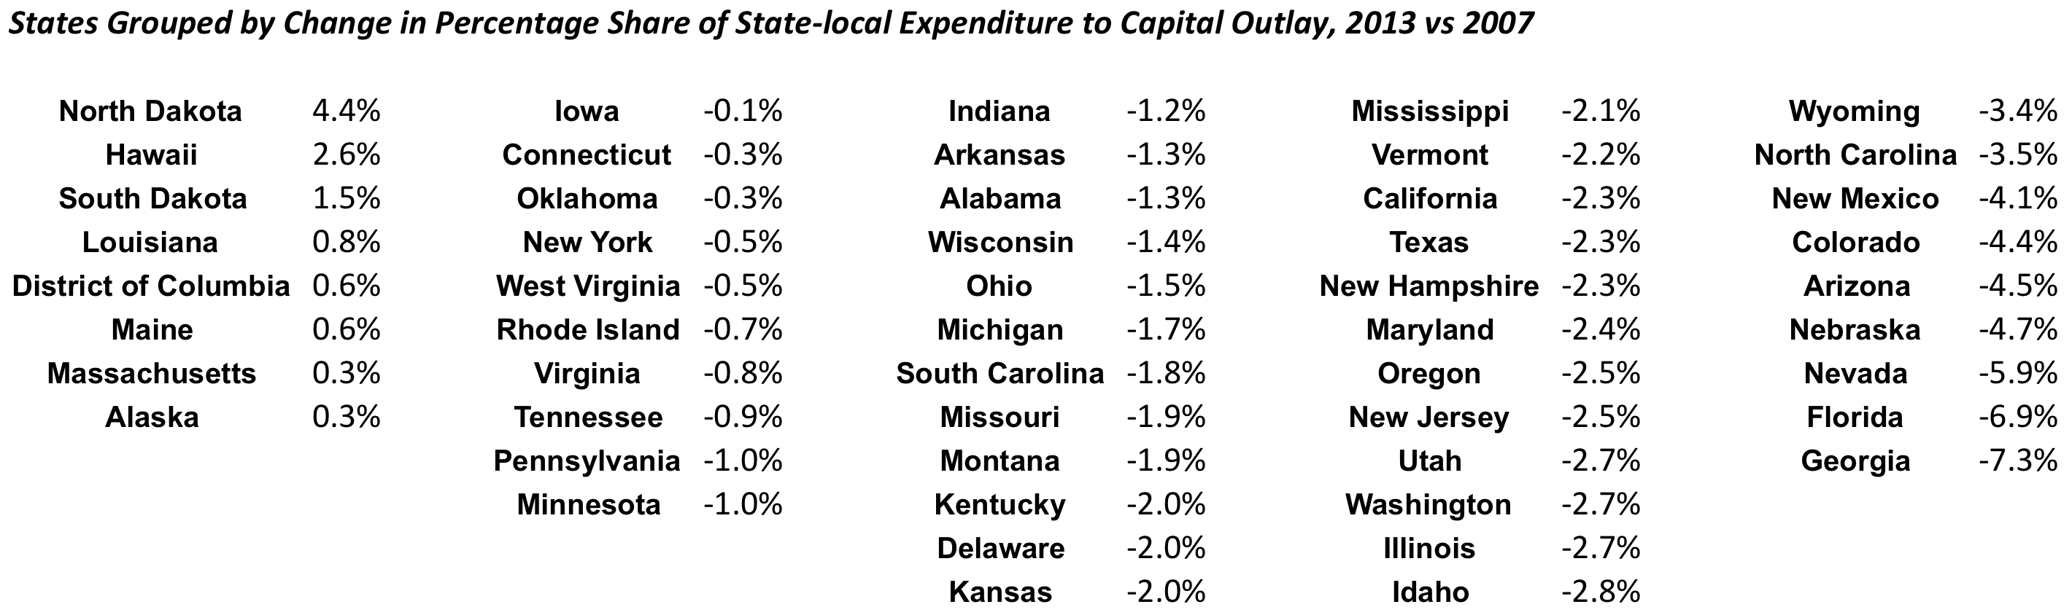

Slide 15
State-by-State Changes in Capital Spending
Why the differences?
Simple descriptive analysis suggests that larger population states had smaller decreases
Other initial characteristics – income & debt – not significant
Medicaid expansion, as a proxy for new expenditure demands, also not significant

Slide 16
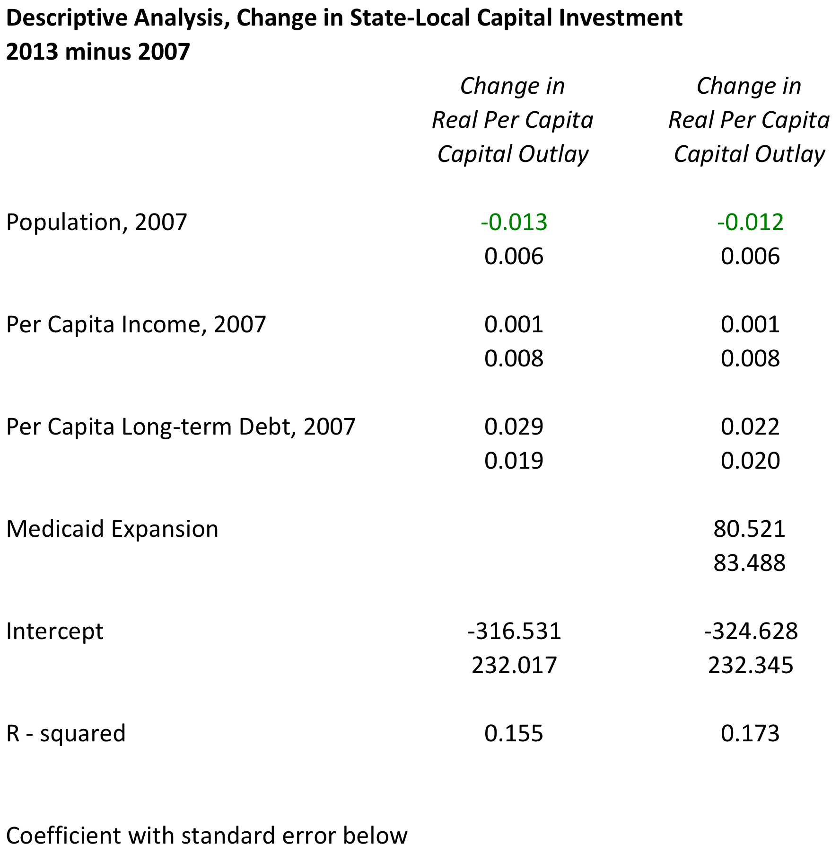

Slide 17
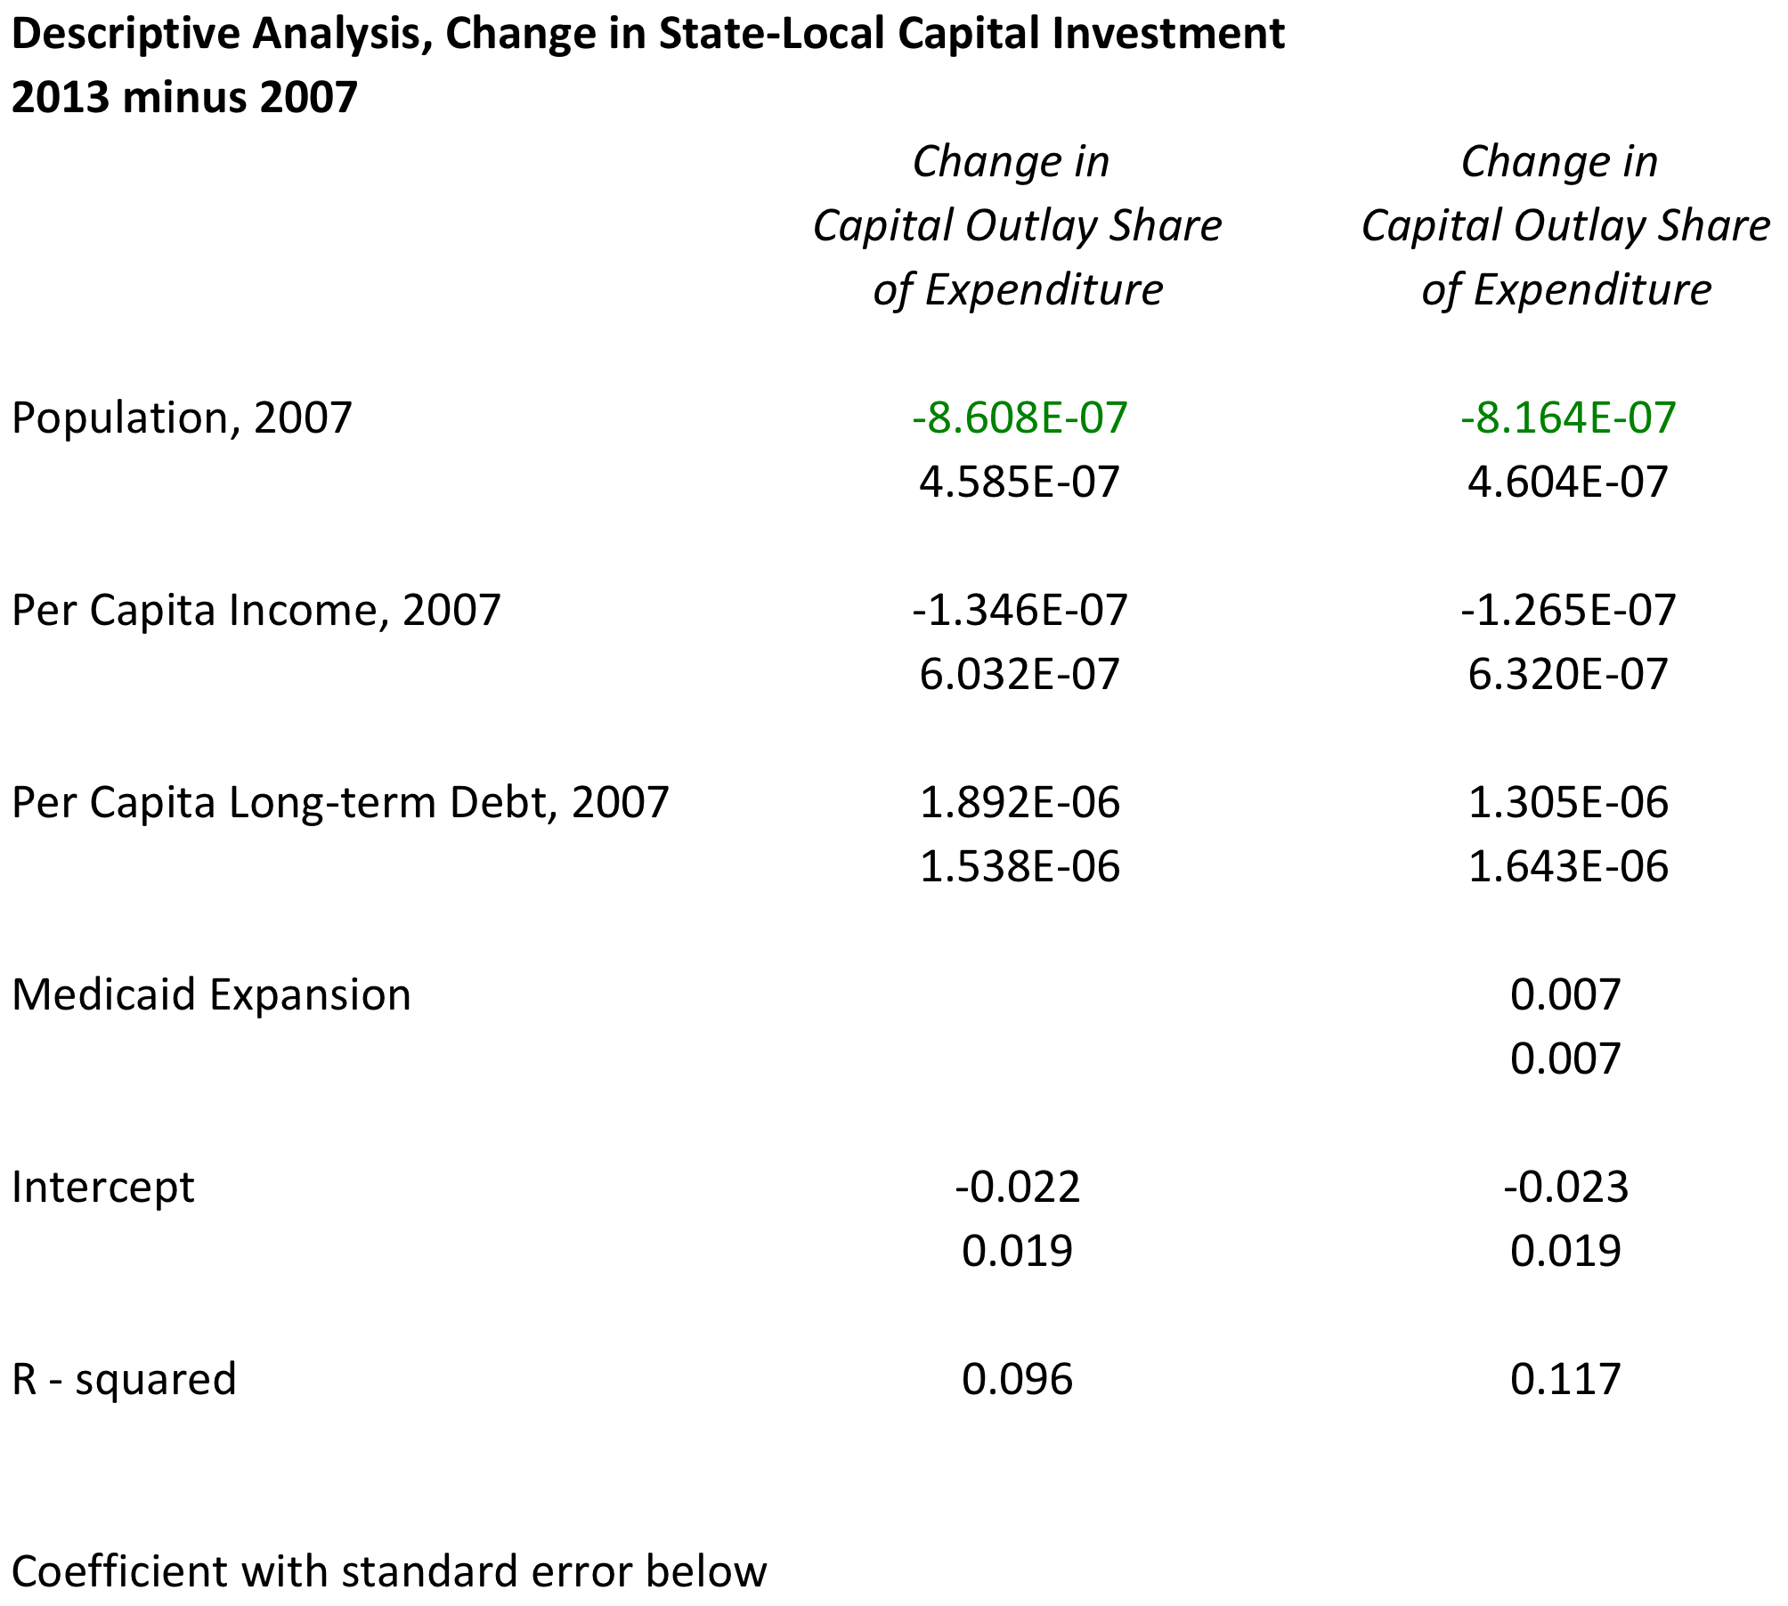

Slide 18
State-by-State Changes in Capital Spending
Simple, explanatory differencing analysis suggests the following:
Change in real per capita capital outlay
  Population change (-); change in real per capita income (+); prior debt (+)
Change in capital outlay share of expenditure
  Population change (-); change in real per capita income (+); prior debt (+)

Slide 19
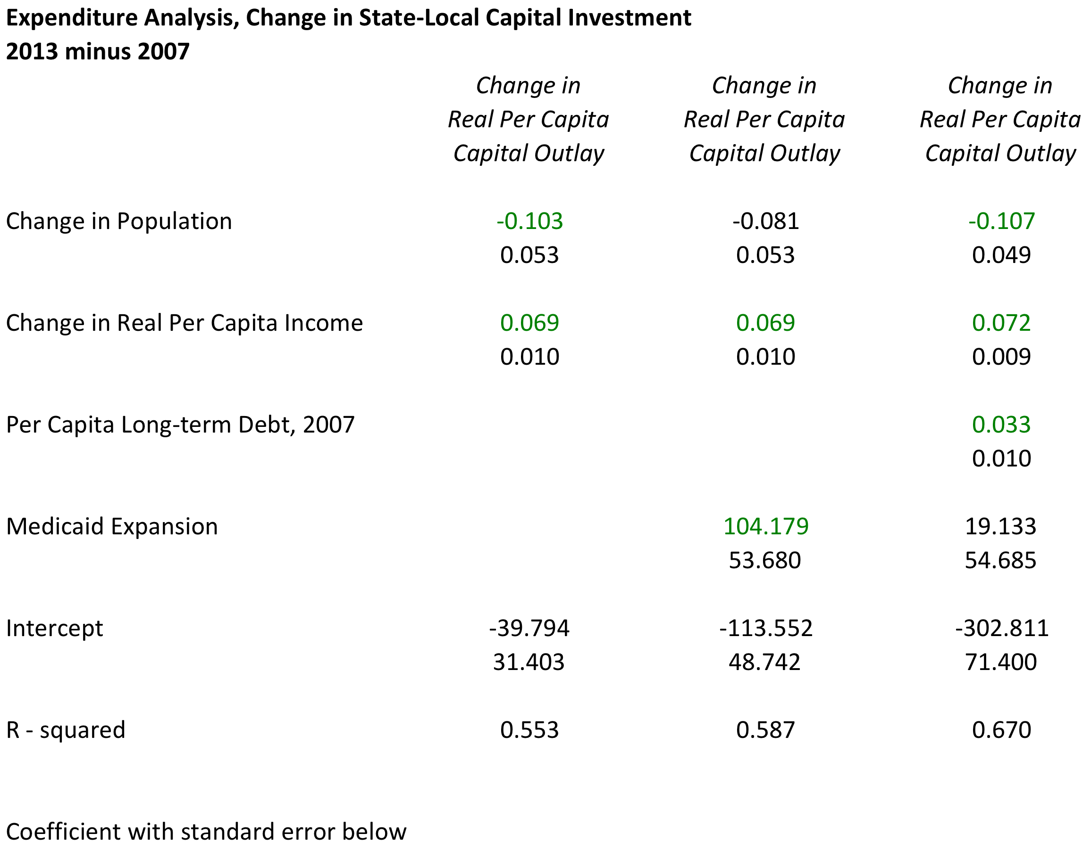

Slide 20
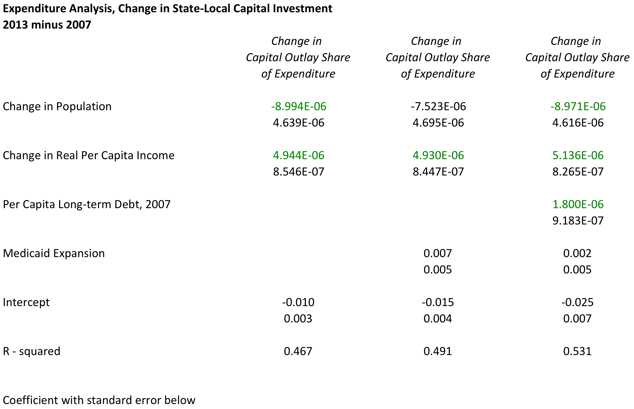

Slide 21
Composition of Capital Investment
Highways the largest category in both years
Highways, higher education, and utilities increased between 2007 and 2013
Elementary & secondary education decreased between 2007 and 2013
Small changes in other categories of state-local capital spending

Slide 22
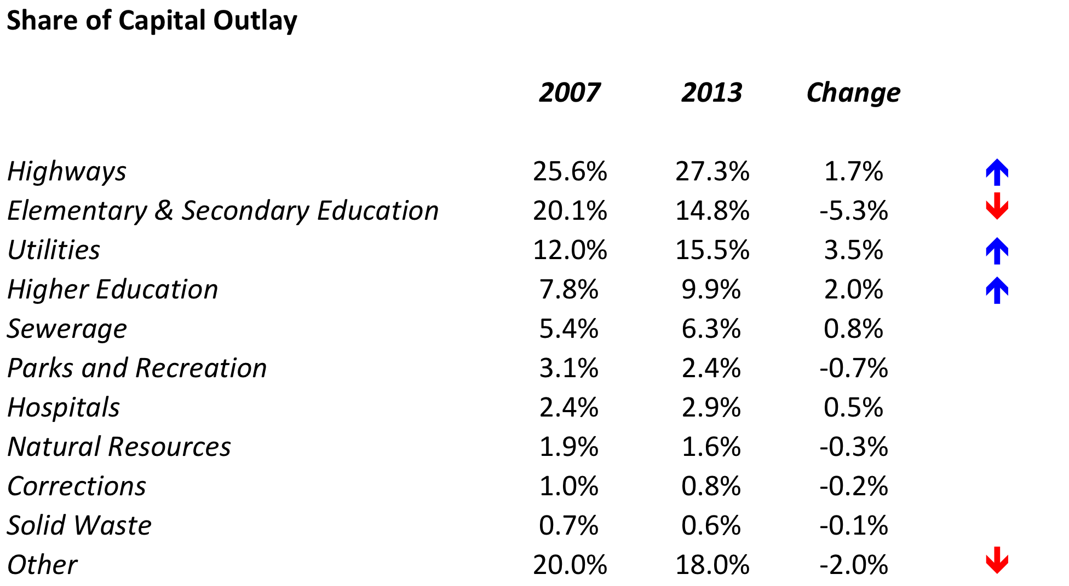

Slide 23
Capital Outlay Historically
In the 1957 to 1967 period, state and local government capital spending was consistently greater than 3.5 percent of personal income.
  Since 2011, state and local government capital spending has been less than 2.5 percent of personal income.
In the period 1952 to 1967, capital spending averaged more than 2.5 percent of GDP
  Less than 2 percent currently

Slide 24
Capital Outlay Historically
In the period 1952 to 1967, capital spending accounted for more than 20 percent of total state and local government expenditure
  Compared to 10 percent recently.
Capital spending in relative terms increased during the recessions since 2000, but remained less than the peak period in the 1950s and 1960s

Slide 28
Comparing Capital Outlay Over Time
Capital spending relative to income (GDP or personal income) and relative to state-local expenditure has declined
But … capital spending relative to population and the general price level has not declined
Is demand for public capital services proportional to population or income?
  Changes in prices of complements; i.e. cars

Slide 29
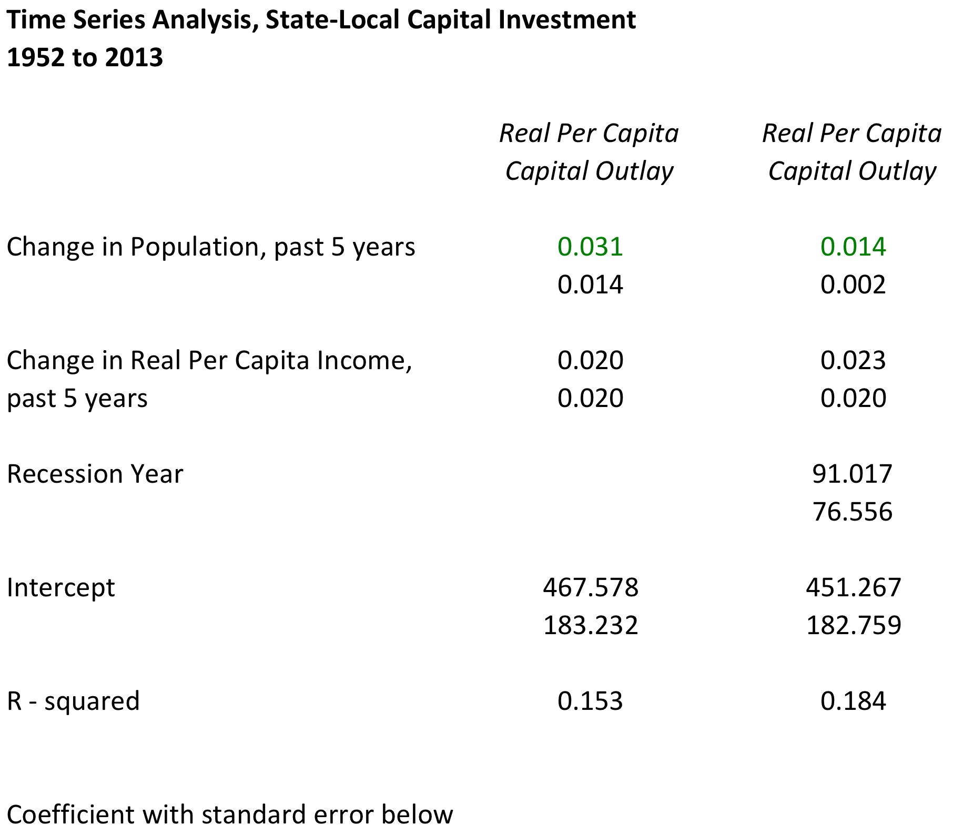

Slide 30
Capital Investment Projections
American Society of Civil Engineers
Original expenditure; Construction-cost changes
Replicate initial expenditure based on fiscal characteristics

Slide 31
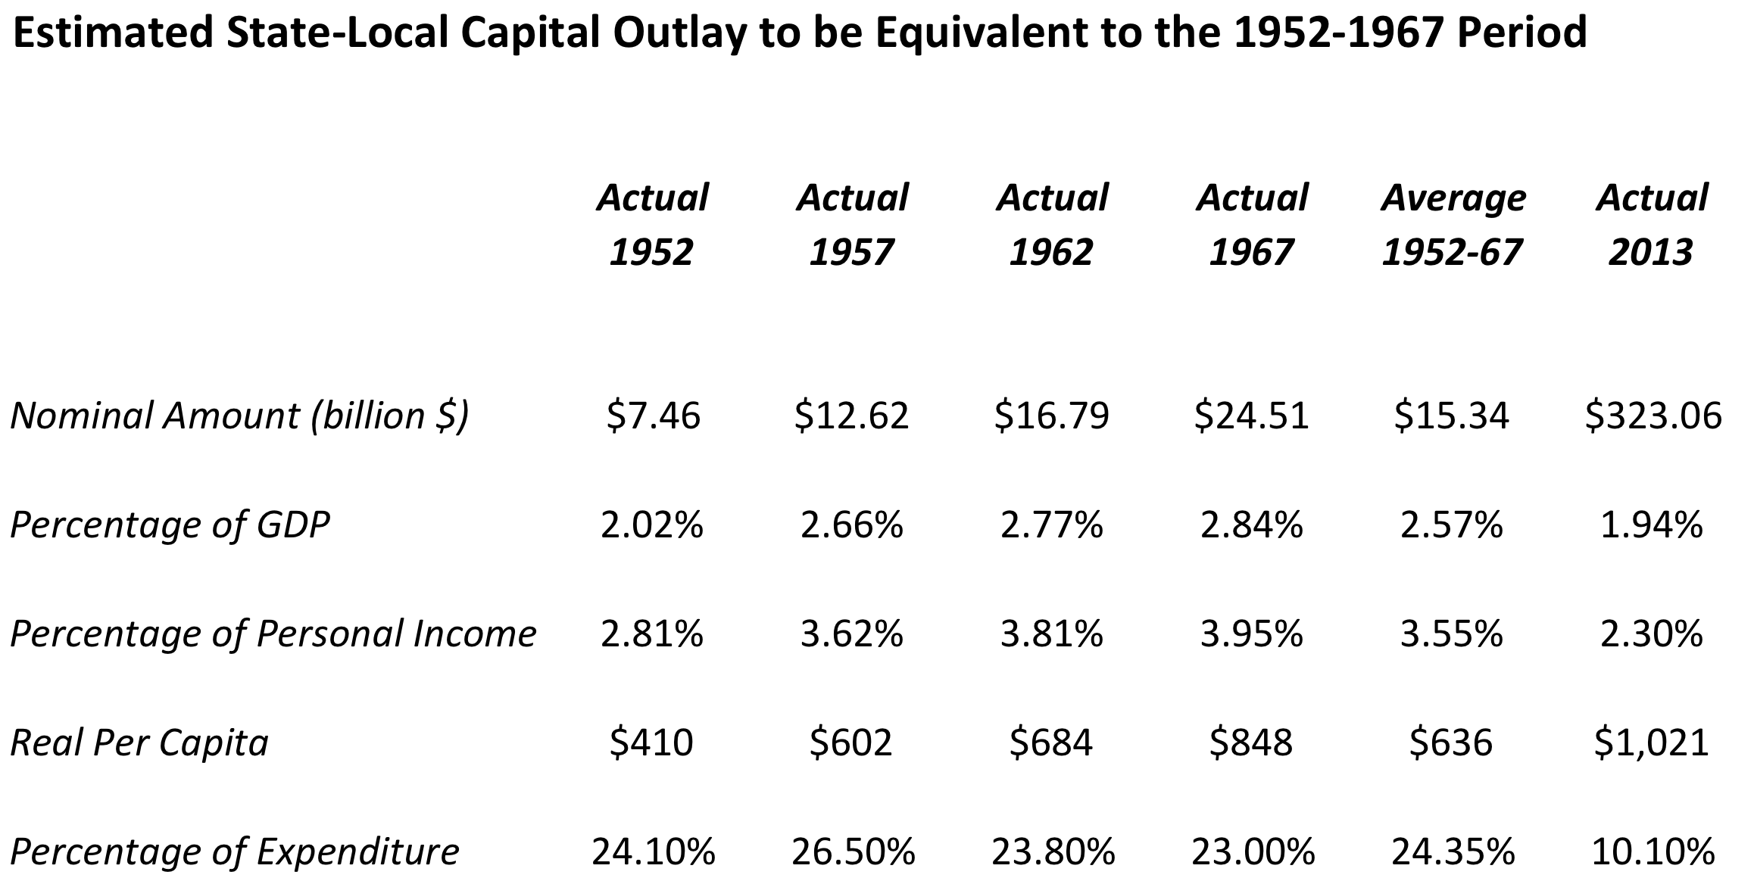

Slide 32
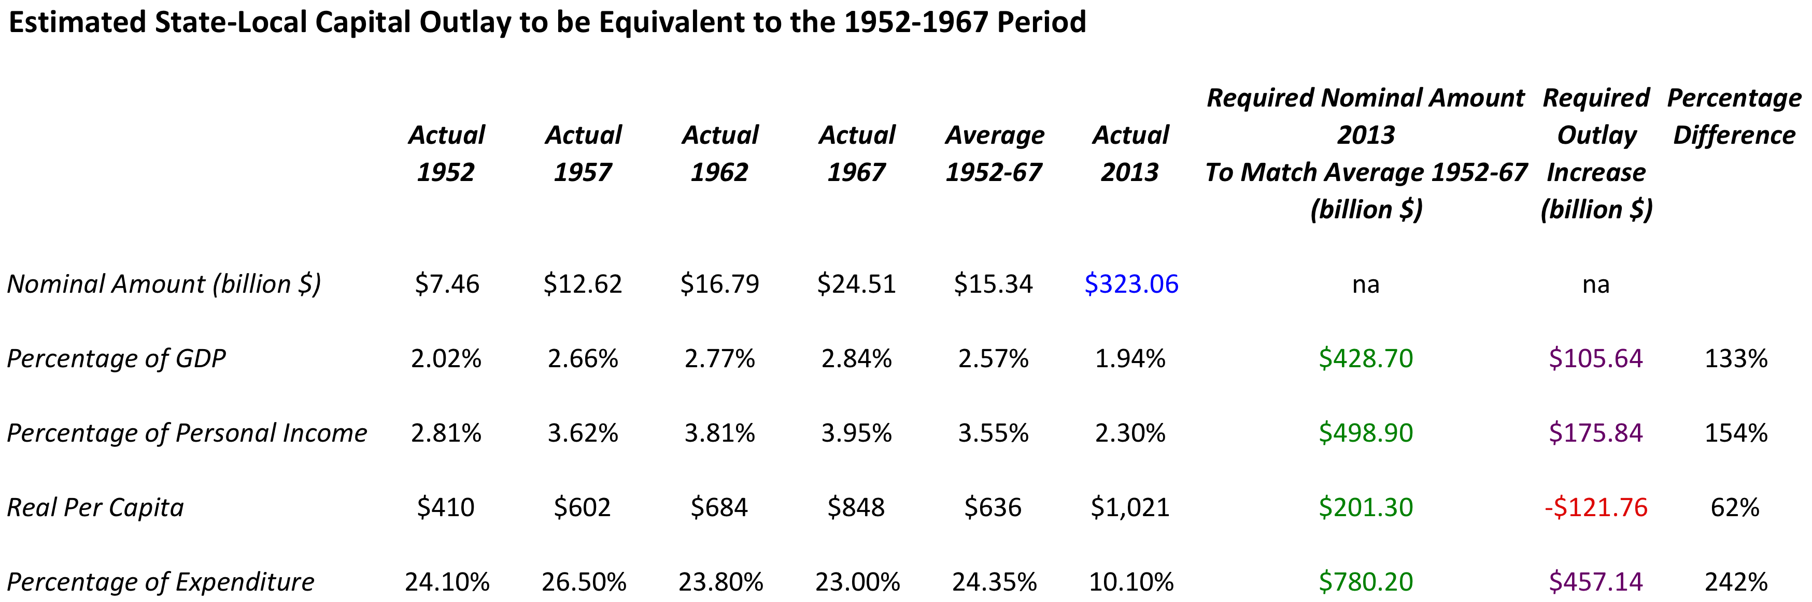

Slide 33
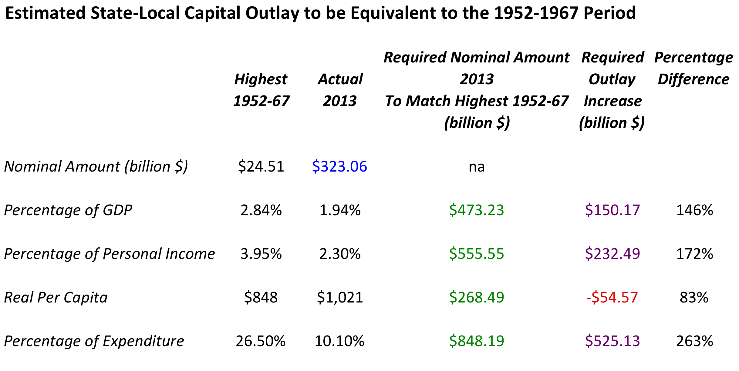

Slide 34
Capital Investment Projections
Replicate 1950s-60s expenditure
  $430-$550 billion annually
  $100-$200 billion annual increase
  $325 billion ➔ $400-$500+ billion
ASCE
  America’s Infrastructure Report Card 2013
  $3.6 trillion by 2020
  $515 billion annually

Slide 35
Further Work/Issues
Explanation for capital spending decline
Time series analysis of capital spending
Changes in the composition of capital spending
???

