Slide 1
What Drives Filing Compliance?
Brian Erard (B. Erard & Associates)
and John Guyton, Pat Langetieg, Mark Payne, and Alan Plumley (IRS RAAS)*
*The views expressed in this presentation are those of the authors
and do not necessarily represent the opinion of the IRS

Slide 2
Filing Requirements
Not everyone is required to file a tax return
One is required to file if …
Income is above a threshold that varies according to filing and dependency status
Owe special taxes (AMT, social security tax on unreported tips, recapture taxes, etc.)
Have net self-employment earnings of more than $400
Received advance premium tax credits payments
Certain other special cases

Slide 3
IRS Concepts: Nonfilers and Voluntary Filing Rate
Nonfiler (Ghost)
Return is required but not filed in a timely manner
Concept includes late filers who eventually file on their own or in response to enforcement action
Voluntary Filing Rate (VFR)
Ratio of timely filed required returns to total required returns in the population

Slide 4
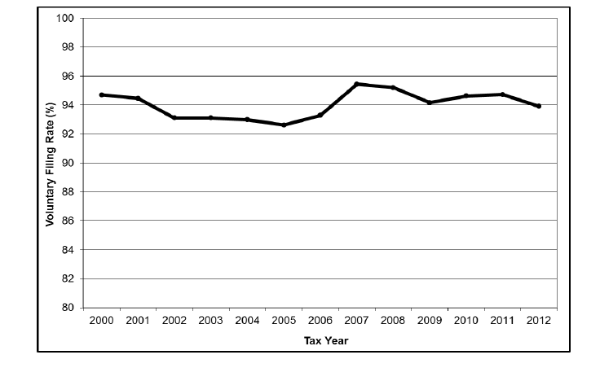
Individual Income Tax Voluntary Filing Rate (VFR), Tax Years 2000-2012

Slide 5
Nonfiling Tax Gap
Individual income tax gap
Individual income taxes owed by taxpayers but not paid in a timely manner
Individual nonfiling tax gap
Portion of the individual income tax gap attributable to net taxes owed by nonfilers
$26 billion per year
8.15% of overall individual income tax gap
Nonfiling also accounts for an estimated $4 billion per year in unpaid self-employment taxes

Slide 6
What Drives Filing Compliance?
Some potential factors:
Filing burden
Balance due/refund
Potential for refundable credits
Income level
State income tax filing requirement
Enforcement risk/Income visibility
Demographics, attitudes, tax knowledge

Slide 7
Traditional Approach to Examining the Drivers of Behavior
Qualitatitive Choice Model of Participation
$$P^{∗}=β_{}^{′}X+ε P=\left\{\begin{matrix}\begin{matrix}1 & \text{Participant}\end{matrix} \\ \begin{matrix}0 & \text{Non}\text{−}\text{participant}\end{matrix}\end{matrix}\right.$$
Estimate model using method of maximum likelihood (logit, probit, etc.)
Then interpret estimate coefficients $β$ to understand the how the various “drivers” $X_{ }$impact participation behavior.

Slide 8
Problem with Traditional Approach
For a traditional logit or probit analysis, we would require:
A representative sample of both filers and nonfilers
An indicator for filing status
We can draw a representative sample of filers from tax return data, but this sample would only include filers
Requirement 1 not satisfied
We can draw a representative sample of both filers and nonfilers from a Census survey, but this sample would not identify which respondents filed and which did not file
Requirement 2 not satisfied

Slide 9
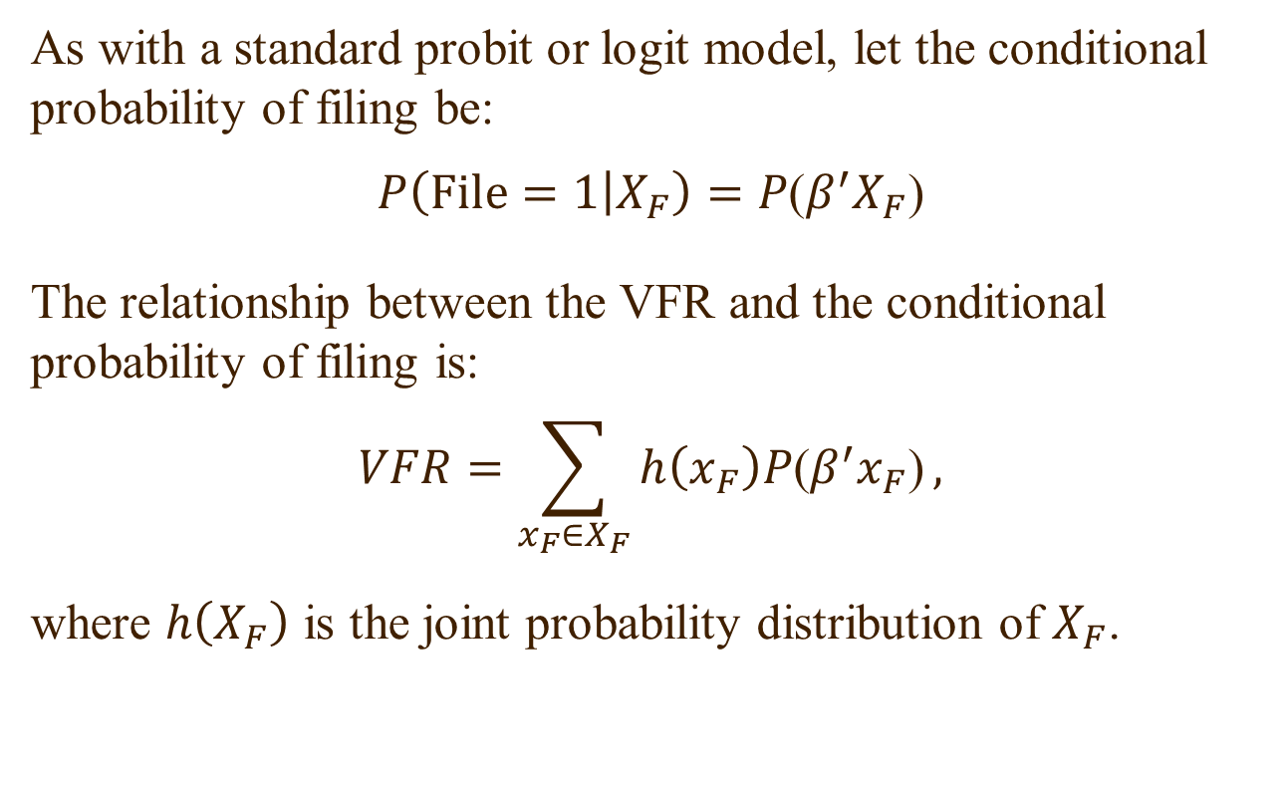
Calibrated Qualitative Choice Framework
As with a standard probit or logit model, let the conditional probability of filing be:
$$P\left(\text{File}=1 | X_{F}\right)=P\text{(}β^{′}X_{F}\text{)}$$
The relationship between the VFR and the conditional probability of filing is:
$$VFR=\sum_{x_{F}∈X_{F}}{h\left(x_{F}\right)P\text{(}β^{′}x_{F}\text{)}},$$
where $h\left(X_{F}\right)$ is the joint probability distribution of $X_{F}$.

Slide 10
Probability of Inclusion in a Filer-Only Sample
Suppose we were to draw only a representative sample of filers. The probability that a taxpayer with characteristics $x_{Fi}$ would be included in such a sample is:
$$\frac{\text{Pr}\text{(}X_{F}=x_{Fi}\text{)∗}\text{Pr}\text{(}\text{file}\text{|}x_{Fi}\text{)}}{\text{Pr}\text{(}\text{file}\text{)}}=\frac{h(x_{Fi})P(β^{′}x_{Fi})}{VFR},$$
The numerator represents the joint probability that a taxpayer would both file and have these characteristics, while the denominator represents the unconditional probability of filing in the population (i.e., the VFR).
The denominator of the above expression accounts for the fact that the sample is restricted only to filers.

Slide 11
Estimation if $h\left(X_{F}\right)$ Were Known
Rather remarkably, if we knew $h\left(X_{F}\right),$the joint distribution of $X_{F}$, we could actually estimate our model based on a filer-only subsample. The likelihood function would be:
$$ℒ=\prod_{i=1}^{N_{1}}{\frac{P({β^{′}x}_{Fi}) }{VFR}.}$$
So we would solve:
$$\max_{β}{\sum_{i=1}^{N_{1}}{ln⁡[P({β^{′}x}_{Fi})}]}$$
subject to the constraint:
$$VFR=\sum_{x_{F}∈X_{F}}{h\left(x_{F}\right)P\text{(}β^{′}x_{F}\text{) }}$$

Slide 12
Estimation When $h\left(X_{F}\right)$ is Unknown
To impose the constraint in the preceding optimization problem:
$$VFR=\sum_{x_{F}∈X_{F}}{h\left(x_{F}\right)P\text{(}β^{′}x_{F}\text{)},}$$
one would need to know $h\left(x_{F}\right)$, which is implausible.
To address this problem, we replace the exact constraint with its analog constructed from a supplementary random sample of filers and nonfilers based on the CPS:
$$VFR=\frac{1}{N_{2}}\sum_{j=1}^{N_{2}}{w_{j}P\text{(}β^{′}x_{Fj}\text{)}}$$

Slide 13
Calibrated Qualitative Choice Model
So we solve:
$$\max_{β}{\sum_{i=1}^{N_{1}}{ln⁡[P({β^{′}x}_{Fi})}]}$$
subject to the constraint:
$$VFR=\frac{1}{N_{2}}\sum_{j=1}^{N_{2}}{w_{j}P\text{(}β^{′}x_{Fj}\text{)}},$$
where $N_{1}$ is the size of our filer-only sample from tax returns, $N_{2}$ is the size of our CPS-based supplementary sample of filers and nonfilers, and $w$ is the CPS sample weight.
Notice that the selected value of $β$is calibrated to ensure that the average predicted probability in the supplementary sample is consistent with the VFR; hence the name “Calibrated Qualitative Choice Model”.

Slide 14
Pooling Cross-Sections
We estimate our model using a time series of cross-sections covering tax year 2000 through tax year 2012.
So we actually solve:
$$\max_{β}{\sum_{t=1}^{T}{\sum_{i=1}^{N_{1t}}{ln⁡[P({β^{′}x}_{Fit})}]}}$$
subject to the $T$ constraints:
$${VFR}_{t}=\frac{1}{N_{2t}}\sum_{j=1}^{N_{2t}}{w_{jt}P\text{(}β^{′}x_{Fjt}\text{)} } t=1,…,T$$

Slide 15
Some Issues
We need to restrict the CPS sample to required returns
Done based on our team’s prior work in measuring the VFR
Explanatory variables need to be present in both data sources
This rules out certain variables, such as presence of a refund/balance due
The explanatory variables also need to be consistently measured across the two data sources
Rules out some additional variables, such as filing status and earned income credit eligibility

Slide 16
Key Findings
Demographics
Filing is more relatively likely if elderly and less likely if married
Income
Filing is positively associated with gross income and negatively associated with being self-employed
Filing is relatively less likely if gross income is near the filing threshold
Burden
Filing is negatively associated with the burden of preparing and filing a return, but less so near filing threshold

Slide 17
Key Findings, Continued
Incentives
Economic Stimulus
Controlling for other factors, filing increased by about 1 percentage point in tax year 2007 in response to the Economic Stimulus, but the impact was temporary.
Expanded EIC for 3 or more children
Controlling for other factors, filing increased among households with 3 or more children from tax year 2009 on (period with extra earned income credit for 3rd child).

Slide 18
Future Work
We recently discovered that our estimates of the VFR over the estimation period were too high.
Our preliminary results based on improved estimates covering a shorter estimation period are qualitatively similar to our initial findings.
We have been working to generalize our framework to account for prior-year filing behavior.
Our preliminary results indicate that having filed a prior-year return increases the likelihood of filing in the current year by 43 percentage points.

