Slide 1
Tax Gaming Under the New Preferences
for Business Income
Ari Glogower, Asst. Professor of Law, Ohio State Moritz College of Law
David Kamin, Professor of Law, NYU School of Law
May 18, 2018

Slide 2
Main Themes
Pick your own adventure in avoiding the top rate: Corporation or 199A.
How corporations can shelter income – deferral or avoidance of second layer of tax.
Arbitrary rules + tax planning under 199A.
Changes driven by idea that “business income” deserves special low rates, but that is an incoherent concept.
Top 1%
(34% of Total)

Slide 3
Pick Your Own Avoidance Adventure: Using Corporations or 199A to Avoid the Top Rate
Top 1%
(34% of Total)

Slide 4
Rate Structure: A Break-Down
 | Tax Rates That Apply
Earned Directly | Up to 40.8% 37% top rate + 3.8% NIIT or Medicare Taxes
Earned Through a C Corp | 21% corporate rate plus 23.8% maximum individual rate on LTCGs and Dividends Effective combined rate of 39.8% Individual-level tax can be reduced or eliminated through tax planning strategies (basis step up, Roth IRA, future lower rates) Subject to limitations: Personal Holding Company, Accumulated Earnings Tax
Earned Through a Pass-Through Qualified for 199A | Up to 33.4% = 29.6% (37% x 0.8) + 3.8% NIIT or Medicare Taxes Subject to limitations: Restrictions on eligible income, amount of deduction (described on later slide)
Top 1%
(34% of Total)

Slide 5
Earning Income Through a C Corp
Top 1%
(34% of Total)
Ordinary Investment Income
Labor Income

Slide 6
Steps for Using a Corporation as a Shelter
Earn income – either labor income or capital income taxed at ordinary rates – through the corporation.
Retain earnings, to maximum extent possible, in corporation. Use planning techniques to avoid personal holding company rules and accumulated earnings tax (lots of pressure on these rules).
If liquidity needed, borrow – and potentially even using corporation as collateral or as source of loan (though, for latter, have to avoid constructive dividend).
Defer second layer of tax to extent possible and potentially entirely eliminate via step up in basis at death.
Top 1%
(34% of Total)

Slide 7
The Rate Differential: Historical Perspective
Source: Authors’ calculations.

Slide 8
Retained Corporate Earnings in the Past Represented Significant Share of Income at Top
Top 1%
(34% of Total)
Source: Authors’ calculations based on backup data from Piketty, Saez, and Zucman, Distributional National Accounts, Quarterly Journal of Economics (2018).

Slide 9
Web of 199A Rules
Winners, Losers, and Tax Games with the 20% Deduction
 | Eligible | Not Eligible
Below $315K in Taxable Income for Married Couple (Half for singles) | Independent contractors, partners, S-corp owners (partially) | Employees. “Reasonable Comp” & 707(a)/(c)
Above $315K in Taxable Income for Married Couple (Half for singles) | Likely eligible: Fields like retail, oil/gas exploration, real estate development | Employees Listed service providers: health, law, etc. Any business where principal asset is reputation/skill of owner/employee Those not paying enough in W-2 wages or owning enough tangible prop
Top 1%
(34% of Total)

Slide 10
Benefits Concentrated at
Top of Income Distribution
Top 1%
(34% of Total)
Authors’ calculations from Joint Committee on Taxation data in JCX-32-18

Slide 11
Benefits Concentrated at
Top of Income Distribution
Top 1%
(34% of Total)
Authors’ calculations from Joint Committee on Taxation data in JCX-32-18

Slide 12
Structuring Around 199A:
“Cracking” and “Packing”
Cracking
Packing

Slide 13
Incoherence of “Business” Income
Logic of this (if there is any) = Biz income should be preferentially taxed relative to other kinds. However, category itself incoherent.
Creates a preference for income of any kind—labor, normal returns to capital, rents—earned as “business” income.
So….
If it’s in a c-corp = biz income
If it’s in a 199A eligible pass through = biz income
Rate structure is NOT an ersatz consumption tax system, which would exempt normal returns to capital but tax labor and rents consistently.
Top 1%
(34% of Total)

Slide 14
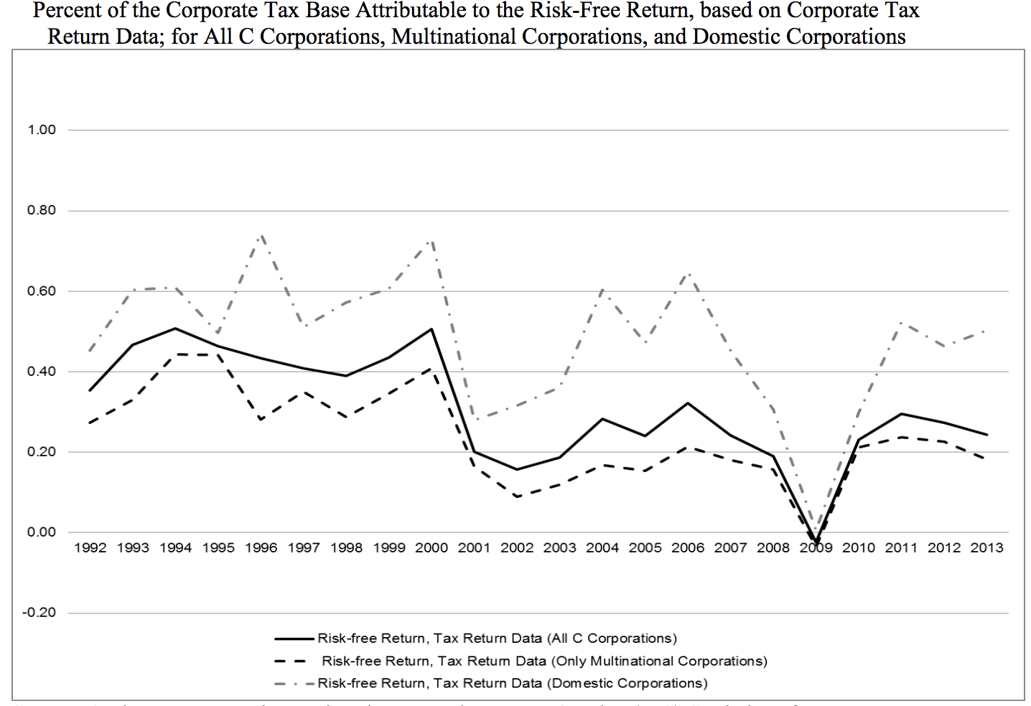
Remember Majority of Corporate
Profits Are Apparently . . . Rents
Top 1%
(34% of Total)
Source: Laura Power & Austin Frerick, Treasury Dep’t, “Have Excess Returns To Corporations Been Increasing Over Time?”, November 2016.

