Slide 1
Cross-border Effects of a Major Tax Reform - Evidence from the European Stock Market Michael Overesch (University of Cologne) Max Pflitsch (University of Cologne)

Slide 2
Motivation and Contribution I
Analyze the European stock market reaction to the “Tax Cuts and Job Act” [TCJA]
TCJA is the largest U.S. tax reform in 30 years
Previous research focusses on domestic effects (Wagner et al. 2018)
Stock markets reactions to foreign tax reforms have rarely been studied (e.g. Bradley et al. 2018, Gaertner et al 2019)
“The inclusion of certain less conventional international tax provisions could contravene the U.S.’s double taxation treaties and may risk having a major distortive impact on international trade.”
(Peter Altmaier, Bruno Le Maire, Philip Hammond, Pier Carlo Padoan, Cristóbal, Montoro Romero)

Slide 3
Key-Facts and International Effects of the TCJA
Significant corporate tax cut
Change from a world wide- to a territorial tax system
BEAT, GILTI and FDII
→ Improvement of international competitiveness of U.S. firms (?)

Slide 4
Hypothesis
European firms could be affected in at least two ways
Directly affected (if they have U.S. operations)
Indirectly affected (if they compete with U.S. firms)
H1: European firms which have significant U.S. operations benefit from the TCJA
H2: European firms which compete heavily with U.S. firms in their domestic markets lose from the TCJA because U.S. firms gain competitiveness (?)

Slide 5
Research Design - Event Date
December 15th 2017:
Conference Agreement published
Two senators announced support for the final version
Former versions (House- and Senate bill) differed widely
Time zone difference
→ Earliest reaction on Monday, December 18th
Notes:
GB0001528156 BE0974271034 GB0030181522

Slide 6
Measuring US Activity (H1) and Competition (H2)
US – Activity is measured by geographic segment data on revenue (not reported coherently, firms report on country-, continental- or other levels)
Not possible to exactly pin down the fraction of revenue obtained in the U.S.
Competition with US firms: Proxy for European market share of US Corporations:
Notes:
‘control’ shall mean the ability to determine the general policy of an enterprise by choosing appropriate directors, if necessary. In this context, enterprise A is deemed to be con-trolled by an institutional unit B when B controls, whether directly or indirectly, more than half of the shareholders’ voting power or more than half of the shares;
REGULATION (EC) No 716/2007 OF THE EUROPEAN PARLIAMENT AND OF THE COUNCIL

Slide 7
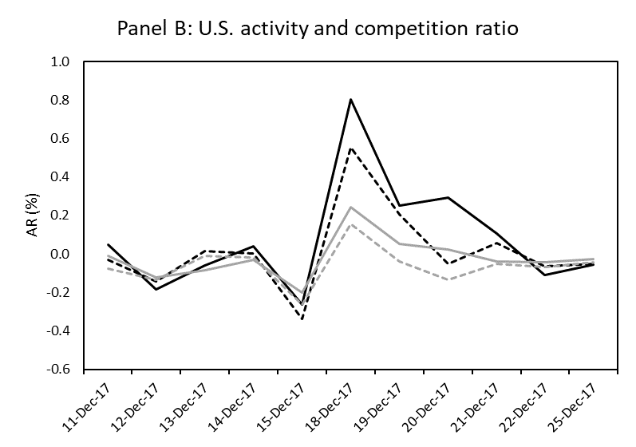
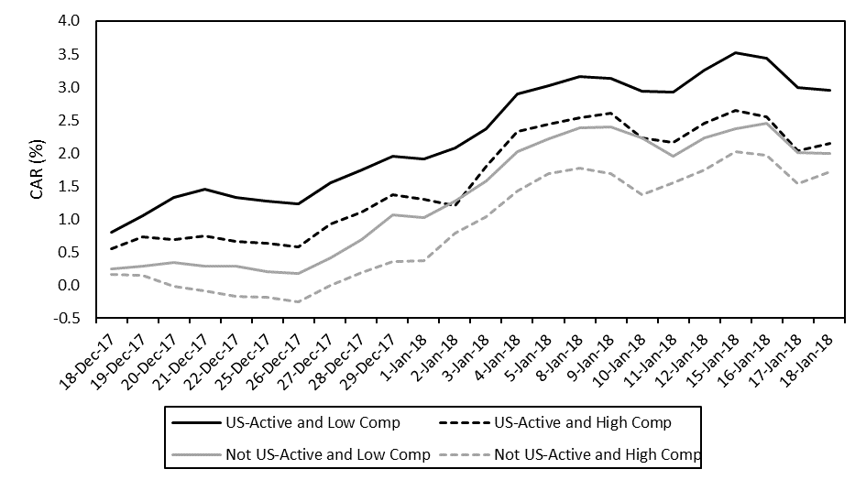

Slide 8
Research Design – Regression Model

Slide 9
Regression Results

Slide 10
Summary
The European stock market was affected by the TCJA
European firms active in the U.S. experienced significant positive abnormal returns
European firms in industries with high U.S. competition had significant lower abnormal returns
These results appear robust in various specifications

Slide 11
Current work in progress:
H1: Assets instead of revenue as the US-Activity proxy
H2: Revenue instead of NoE of US-CFC‘s to compute the competition measure
Searching further proxies for US competition
Evaluate change in ETR as a proxy for US Activity (Gaertner et al. 2019)
Price and variance contribution analysis (Wagner et al. 2018)
Examine more event dates
Joint tests for CAR‘s using multiple event dates

Slide 12
Appendix

Slide 13
Additional Dates

Slide 14
Descriptive Statistics
Statistic | N | Mean | St. Dev. | Min | P25 | P75 | Max
Gross return Dec. 18 | 1,675 | 0.68 | 1.61 | -4.77 | -0.14 | 1.66 | 5.65
Abnormal return Dec .18 | 1,675 | 0.45 | 1.57 | -5.03 | -0.37 | 1.30 | 5.64
CGR Dec. 18 to Dec. 27 | 1,691 | 1.08 | 3.45 | -10.43 | -0.89 | 2.95 | 15.34
CAR Dec. 18 to Dec. 27 | 1,691 | 0.76 | 3.46 | -11.51 | -1.20 | 2.74 | 16.68
CGR Dec. 18 to Jan. 18 | 1,692 | 3.84 | 6.21 | -25.78 | -0.02 | 7.39 | 38.08
CAR Dec. 18 to Jan.18 | 1,692 | 2.21 | 6.27 | -20.73 | -1.62 | 5.70 | 30.35
MM Beta | 1,675 | 0.36 | 0.30 | -0.80 | 0.14 | 0.58 | 1.55
Market capitalization | 1,675 | 4,778.26 | 14,821.27 | 4.90 | 168.84 | 2,979.00 | 225,094.60
Growth of sales | 1,675 | 13.70 | 88.71 | -100.00 | 1.47 | 16.33 | 3,300.00
Profitability | 1,675 | 6.36 | 13.77 | -184.92 | 3.13 | 10.64 | 248.17
US Activity | 1,675 | 0.55 | 0.50 | 0 | 0 | 1 | 1
US Comp EU | 1,675 | 5.62 | 3.67 | 0.10 | 2.22 | 8.15 | 17.27
All values are in percent except for the Beta coefficient and the US Activity variable.

Slide 15
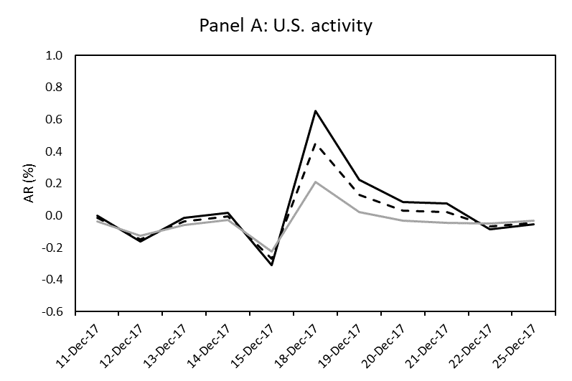
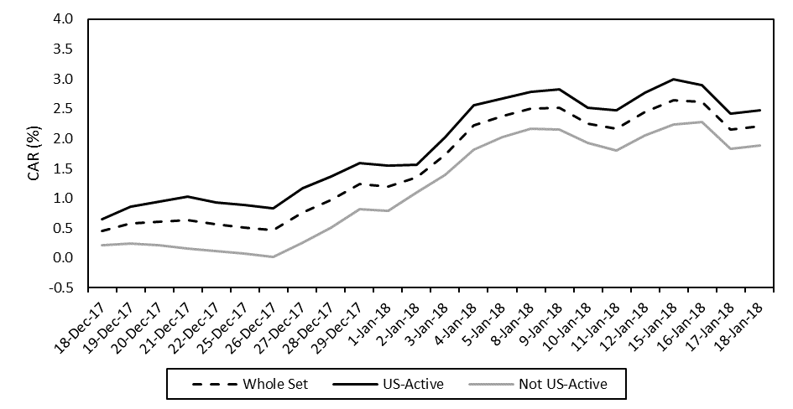

Slide 16
Cross-correlation and event induced volatility

Slide 17
Competition Ratio Based on Revenues

Slide 18
Alternative ways to compute the normal return

Slide 19
Return transformation

Slide 20
Research Design - Normal Return Estimation

