Slide 1
Enterprise Zones in Indiana
Anita Yadavalli, Ph.D.
Senior Fiscal Analyst
Indiana Legislative Services Agency

Slide 2
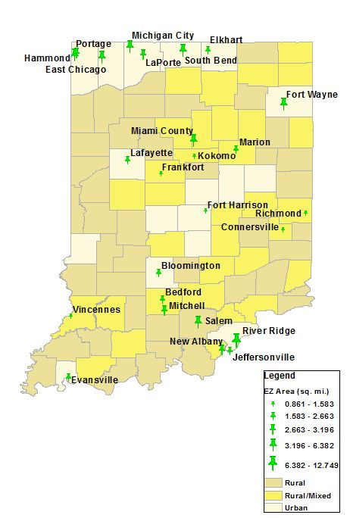
Enterprise Zones
EZs are utilized for the revitalization of traditional downtown areas or old industrial and manufacturing areas that have gone through a protracted period of decline.
Zone businesses, which are designated on the basis of high unemployment and poverty rates, receive some combination of labor and capital tax incentives.
Program Incentives
Investment deduction
Employment expense credit
Loan interest credit
Employee income deduction
Investment cost credit

Slide 3
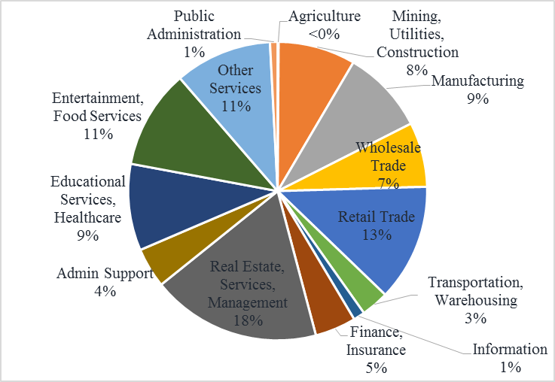
EZ Firms by Industry

Slide 4
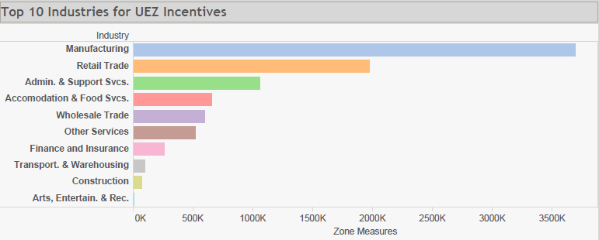
Which Firms Are Claiming Incentives?
Majority are claimed by manufacturing firms, which make up only 9% of all zone businesses.
Manufacturing firms also employ 3 times as many workers, suggesting that large manufacturing firms are utilizing the tax incentives.

Slide 5
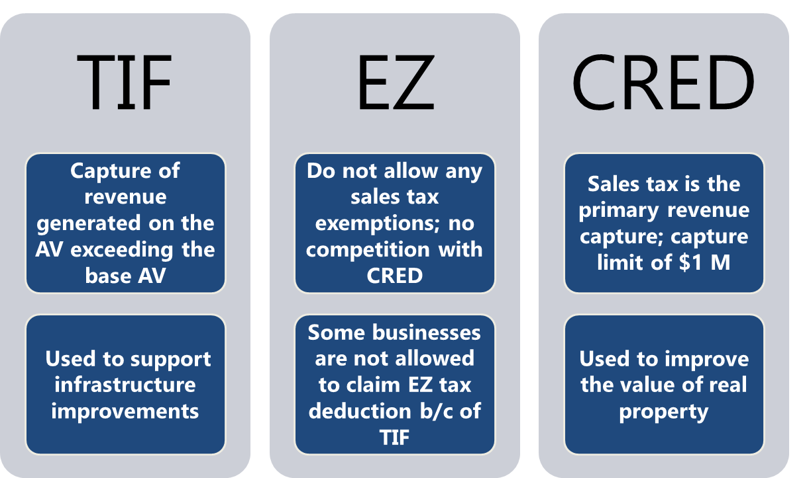
Effect of Economic Development Efforts on EZ Tax Savings

Slide 6
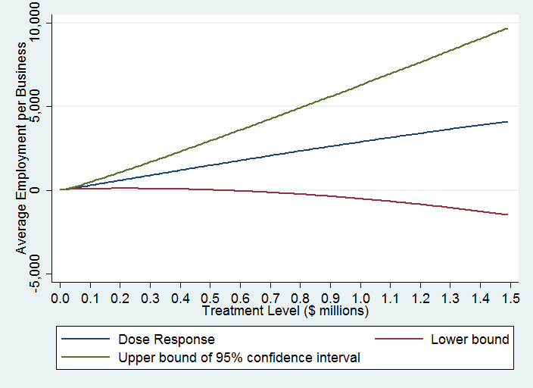
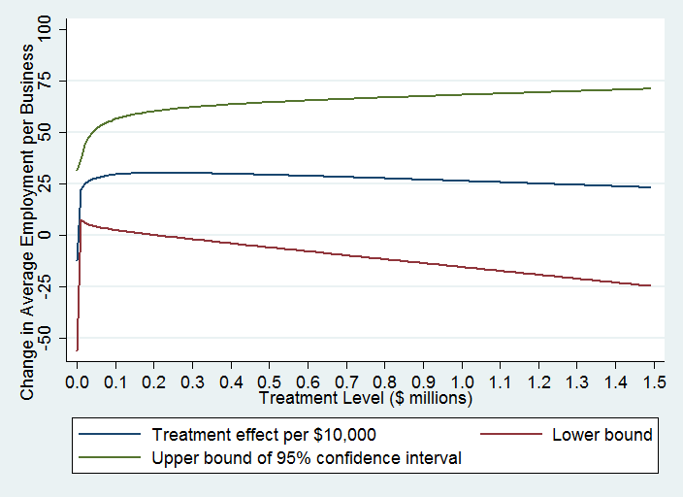
Impact on All Employment
Estimated Effect of Incentive on Employment
Marginal Effect of $10,000 increase in Incentive

Slide 7
Enterprise Zone Participation Fees
Many local UEAs use their revenues for community development projects.
Urban Enterprise Association | 2013-2014 |  | 2014-2015 |  | 2015-2016
 | Total Revenue | Participation Fee % of Total Revenue | Total Revenue | Participation Fee % of Total Revenue | Total Revenue | Participation Fee % of Total Revenue
Bedford | $103,000 | 63% | $108,000 | 75% | $85,000 | 100%
East Chicago | 512,950 | 20% | 235,184 | 34% | 217,718 | 35%
Evansville | 346,834 | 83% | 326,987 | 98% | 371,974 | 98%
Fort Wayne | 419,063 | 60% | 436,556 | 64% | 459,393 | 68%
LaPorte | 179,565 | 98% | 451,263 | 99% | 695,899 | 99%
South Bend | 284,898 | 98% | 62,206 | 93% | 54,000 | 93%
Vincennes | 106,888 | 100% | 110,093 | 100% | 112,289 | 100%
Source: Indiana Urban Enterprise Associations

Slide 8
Thank You
anita.Yadavalli@iga.in.gov

