Slide 1
$15 Minimum Wage Policy: The Effect on Workers and a Work-Based Safety Net
Fahad Fahimullah
Yi Geng
Bradley Hardy
Daniel Muhammad
Jeffrey Wilkins
NTA Conference
November 11th, 2017
Office of Revenue Analysis – District of Columbia Government

Slide 2
Outline
Background & Introduction
Why a Computable General Equilibrium Model?
Data & Methods
Results
Conclusion

Slide 3
Motivation & Research Question
Motivation: Policymakers had 5 critical questions about this policy
What would be the magnitude of job loss?
How would the policy affect EITC credit for low wage city residents?
How would this policy impact business competitiveness vs. MD &VA businesses?
What would the effect of this policy be on city net tax revenue?
Would there be any unintended consequences for the city’s economy?
This study aims to answer the first three questions above
Other factors to consider:
Border effects/ DC’s share of regional economy
DC workforce composition (residents v. non-residents)
Large magnitude of wage increase

Slide 4
Minimum Wage Policy
The Fair Shot Minimum Wage Amendment Act of 2016 increases the minimum wage to $15 by 2020 and pegs it to CPI beginning in 2021
Prior to this, the minimum wage was capped at $11.50 in July 2016 and tied to inflation thereafter
Date | Hourly Wage | Annual Full Time Salary*
Prior to July 2014 | $8.25 | $17,160
7/1/2014 | $9.50 | $19,760
7/1/2015 | $10.50 | $21,840
7/1/2016 | $11.50 | $23,920
7/1/2017 | $12.50 | $26,000
7/1/2018 | $13.25 | $27,560
7/1/2019 | $14.00 | $29,120
7/1/2020 | $15.00 | $31,200
* Based on 40 hours worked per week

Slide 5
Minimum Wage Policy (cont.)
~30% increase in statutory minimum wage from 2016-2020 ($11.50 to $15.00)
From 2013-2020, DC will increase its wage by 82% ($8.25 to $15), the largest increase in the nation during this time frame
Without the new $15 policy, the previous policy would have crossed $15 in 2028. With the new policy, by 2028 the minimum wage will be approx. $18
Based on 2.3% projected inflation from 2016 to 2032.

Slide 6
Why We Use a CGE Model
Many minimum wage studies exist, but most rely on partial-equilibrium analysis to evaluate historical changes (usually of small $ increases and often for specific subsets of the population)
Our study aims to evaluate what will happen in the future, with a nearly 30% increase in the minimum wage over 4 years
The Computable General Equilibrium model we use (REMI) offers annual impacts into the future, taking into account dynamic changes in the economy such as behavioral changes from both businesses and consumers
It provides a more thorough output of the many impacts that can be expected from a policy change of this magnitude (i.e. price impacts, GSP changes, labor & capital substitution, etc.)

Slide 7
Data & Methods
Using BLS OES data, we estimate the number of workers who earn $15 or less in DC and those who earn $15-$18 (spillover effects)
115,727 workers earn $15 and below
36,144 workers earn $15-$18
Total of 151,871 workers (20.2% of all workers in DC)
Increase of minimum wage equates to ~$492 million for these workers before any economic reactions take place
Using Census ACS data, we find that about 40% of the workers above are DC residents. This is 60,748 resident workers (17.6% of all DC resident workers)
Increase of minimum wage equates to ~$197 million for these workers before any economic reactions take place

Slide 8
Scenarios & Assumptions in CGE Model
Scenario | Description | Assumption
Case 1 | Base Case | Only workers currently earning less than $15/hour will benefit
Case 2 | Case 1 + Spillover Effect | In addition to Case 1, workers earning slightly above minimum wage ($15-$18/hour) will also benefit
Case 3 | Case 2+ Productivity Savings | In addition to Case 2, higher minimum wage will increase workers’ productivity and reduce turnover & recruiting costs. Total Saving = 30% of the increase in business cost
Case 4 | Case 3+ Consumption Effect | In addition to Case 3, minimum wage workers will spend most of their extra income on consumption
Case 5 | Efficiency Wage | Same as in Case 4, but total savings from higher productivity, lower turnover &recruiting costs are greater. Total Savings = 75% of the increase in business cost.
We input a new shock to the model ($xx million increase in labor cost) for each scenario and re-run the model.

Slide 9
Results
While low-wage workers ($18/hour and below) are positively impacted by the policy, city-wide, the economy is negatively affected
Each scenario impacts on the order of -0.5% in terms of DC’s GSP
This policy has city-wide ramifications

Slide 10
Results
This chart shows the job loss impact on all DC workers

Slide 11
How is the Higher Minimum Wage Financed?
The Net Effect on Wages is $394mm in 2021
The Net Increase in Business Costs $129mm in 2021

Slide 12
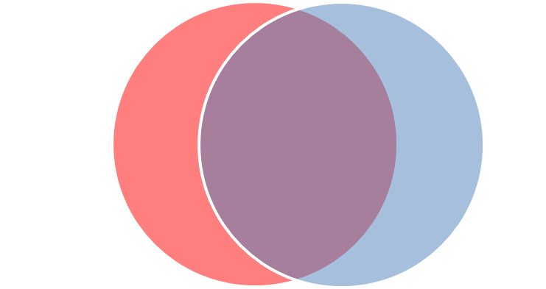
Effect on EITC Recipients
For the average EITC recipient | Without $15 MWP | With $15 MWP | Net Difference
 |  |  | $ Amount | % Change
Avg. Wage & Salaries | $20,095 | $23,192 | $3,097 | 15.4%
Avg. DC Indiv. Inc. Tax | $355 | $384 | $29 | 8.2%
Avg. Federal EITC | $2,538 | $2,344 | ($194) | (-7.6%)
Avg. DC EITC | $1,807 | $1,670 | ($137) | (-7.6%)
EITC Recipients
(57,000 tax filers)
DC Residents who benefit from both public policies
(~38,000 Residents)
DC has one of the nation’s most generous EITC federal match rates, at 40%
In TY 2014, almost 57,000 DC residents claimed the DC EITC credit
In TY 2014, over $55 million in DC EITC was distributed

Slide 13
Conclusion & Implications
Conclusions
$394 million more in net wages to DC workers (regardless of residency)
But almost 1,075 job losses for DC residents
DC business competitiveness decreases as prices increase
EITC recipients lose some of their credit (as their wages increase), but overall they are better off as higher wages more than offset the decrease in credit
Implications
Shifting from public to private in terms of assistance towards low-income earners
DC’s workforce composition requires DC to aide non-residents as a byproduct of assisting DC residents
DC is attempting to include the lowest wage-earning residents in the city’s significant economic growth and to help serve as an offset against the city’s rapidly increasing cost of living

Slide 14
Thank You
Questions?

Slide 15
DC GDP and Its Components (millions)
 | 2020 | 2025 | 2032
Consumption ($36bn) | $ 116 (0.32%) | $ 116 (0.30%) | $ 92 (0.22%)
Investment ($17bn) | $ 7 (0.06%) | $ -14 (-0.10%) | $ -34 (-0.19%)
Government Expenditures ($47bn) | $ -4 (-0.01%) | $ -13 (-0.03%) | $ -20 (-0.04%)
Net Exports with Rest of USA ($18bn) | $ -170 (-0.94%) | $ -219 (-1.18%) | $ -202 (-0.96%)
Net Changes in Real GDP | $ -51 (-0.04%) | $ -130 (-0.11%) | $ -164 (-0.12%)

